Slide 1
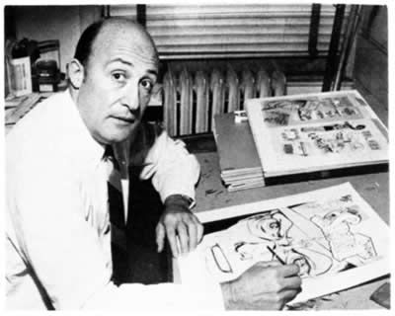
Monster Comics
EQ: How will you create a comic strip using the character provided by an elementary student?
How will you make your comic aesthetically appealing and ready for exhibit using your knowledge of the art elements and principles of design?
Will Eisner (Above)

Slide 2
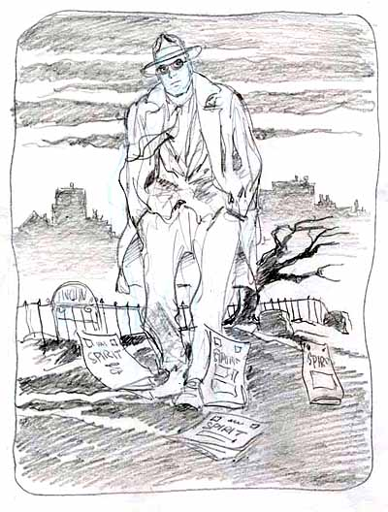
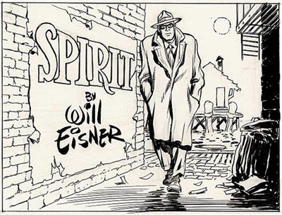
Wizard magazine named Eisner "the most influential comic artist of all time."

Slide 3
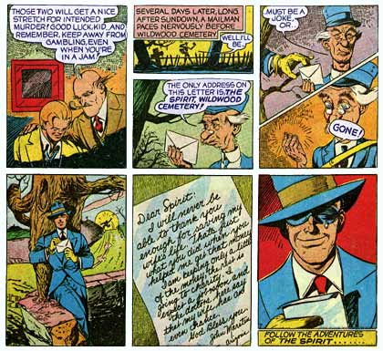

Slide 4
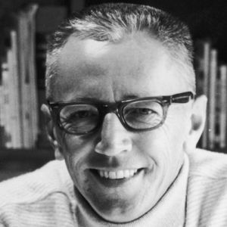
Charles M. Schulz “Peanuts”
“I have been told, an uncle came in and looked at me and said, ‘By golly, we’re going to call him Sparkplug.’ So, I’ve been called Sparky since the day after I was born – named after a comic strip character.”
Charles M. Schulz (1984)

Slide 5
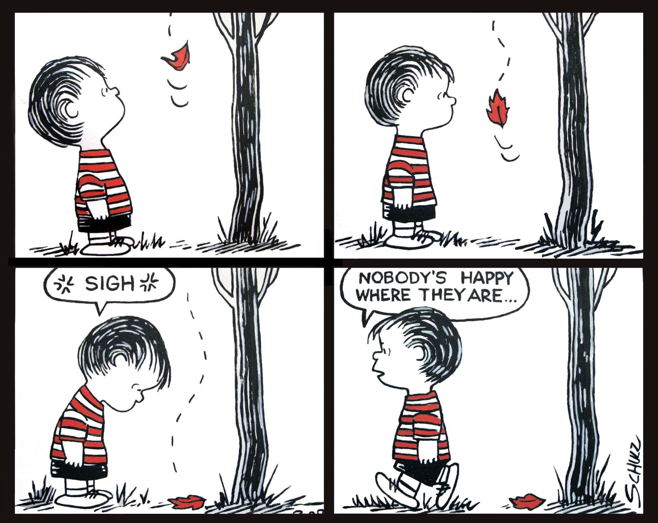
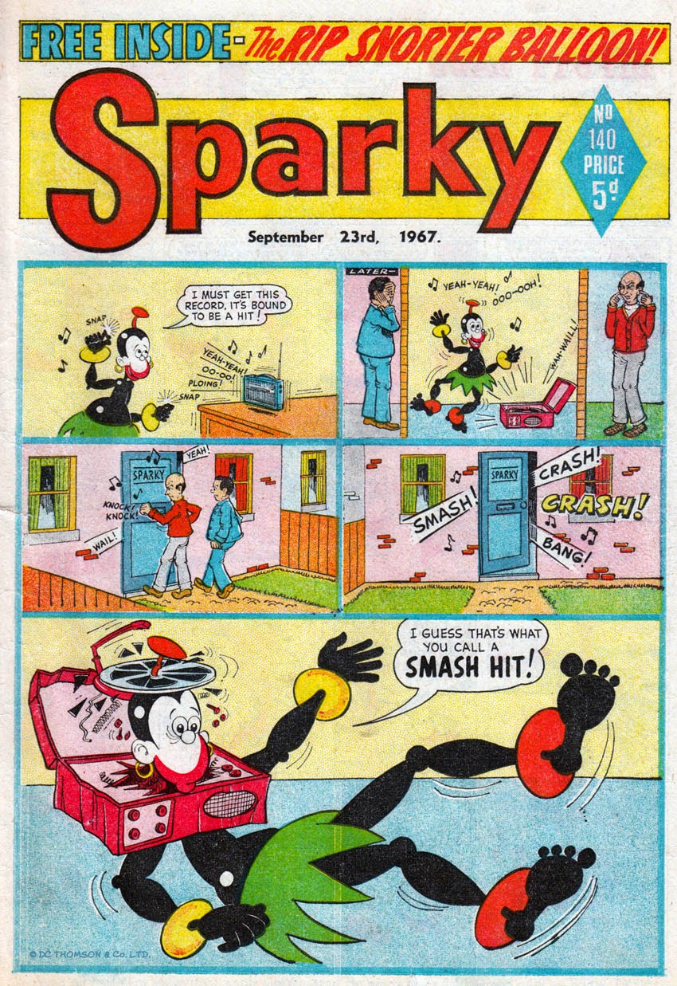

Slide 6
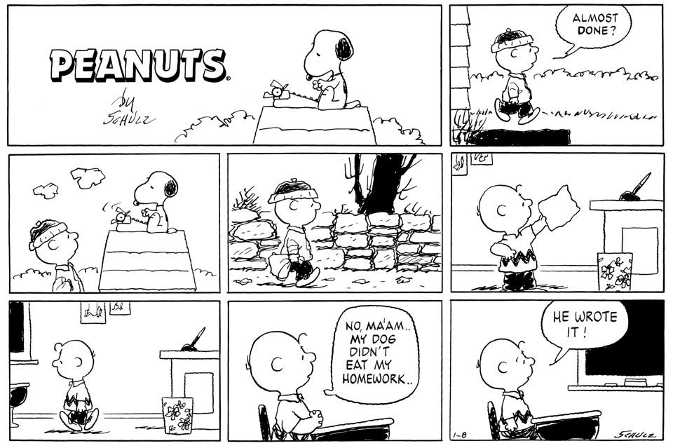
“My earliest recollection of drawing and getting credit for it and being complimented on it is from kindergarten. I think it was my first day, and the teacher gave us huge sheets of white paper, large black crayons, and told us to draw anything we wanted. I drew a man shoveling snow, and she came around, paused, looked at my picture, and said, ‘Someday, Charles, you’re going to be an artist.’ Now she wasn’t quite right – she didn’t say ‘cartoonist’ – but there was an interesting aspect to this. I had drawn the snow shovel as a square, but I knew this was not right. I knew nothing about perspective, and didn’t know how to fix it, but I knew that something wasn’t right about this picture. I like to think there was some anticipation there of what was to come.”
Charles M. Schulz (1985)

Slide 7
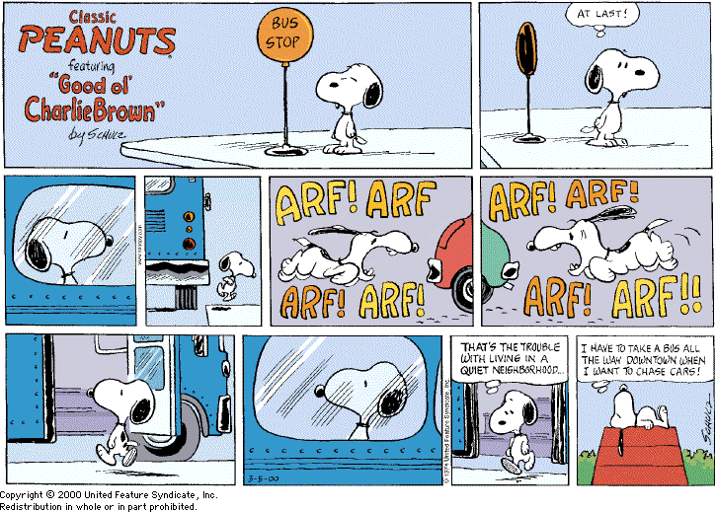
“The first dog I ever had was a Boston bull named Snooky. She got run over by a taxicab when she was about ten years old and I was about twelve…about a year later we got a dog named Spike, and he was the inspiration for Snoopy.”
Charles M. Schulz (1980)

Slide 8
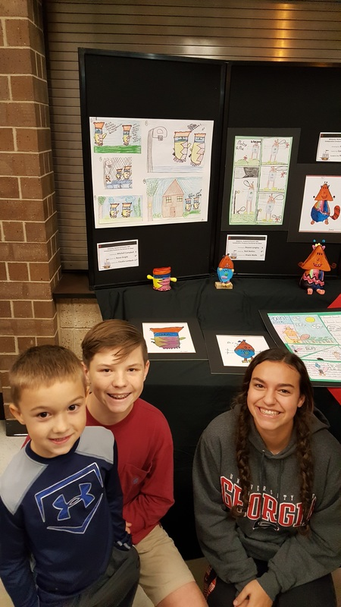
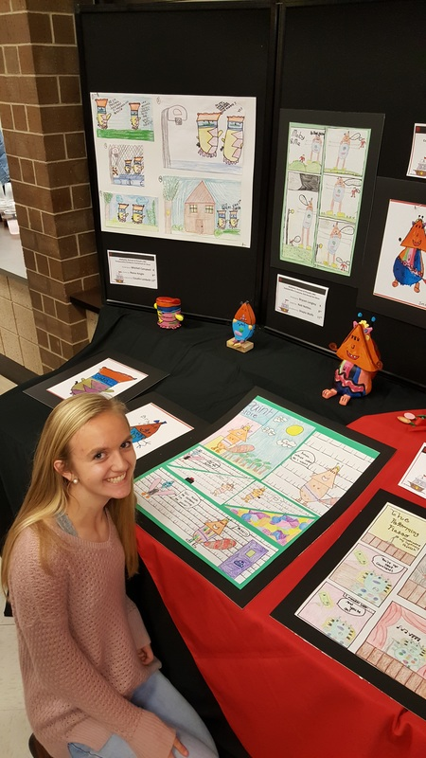
DAY 1
Today I am….
Drawing in my sketchbook
Selecting my character
Creating preliminary sketches
So That I can….
Develop and build my drawing skills
Plan and prepare for my art work
I am successful When I….
Draw in my sketchbook for 7 min.
Create my preliminary sketches for my comic

Slide 9
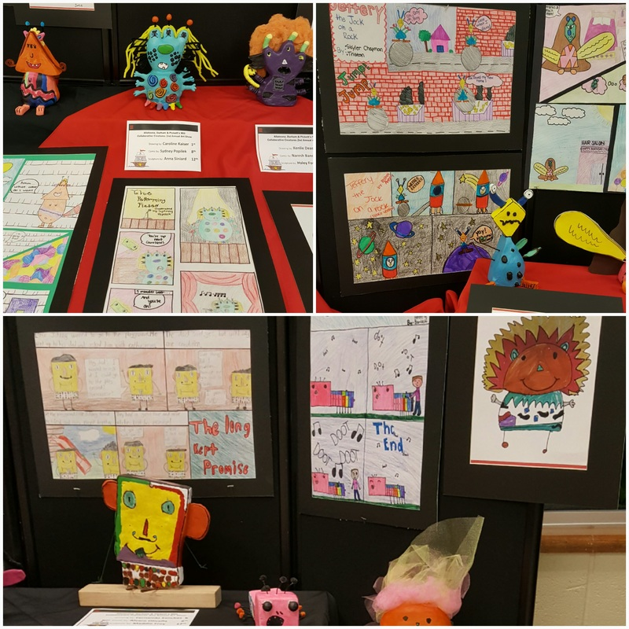
DAY 2-7
Today I am….
Drawing in my sketchbook
Creating a comic strip
So That I can….
Develop and build my drawing skills
Collaborate with others
I am successful When I….
Draw in my sketchbook for 7 min.
Create a comic strip ready for exhibit

Slide 10
Requirements:
Practice drawing character(s) in sketchbook
Create a title box with illustrators name
Draw at least 3 illustrations in your storyboard
Make sure you overlap objects (create depth and 3D)
Create the character exactly how the student designed it
Make sure to fill space of each box (Foreground, middle-ground, and background
Draw character from different points of view
Apply at least one speech balloon in comic strip

