Slide 1
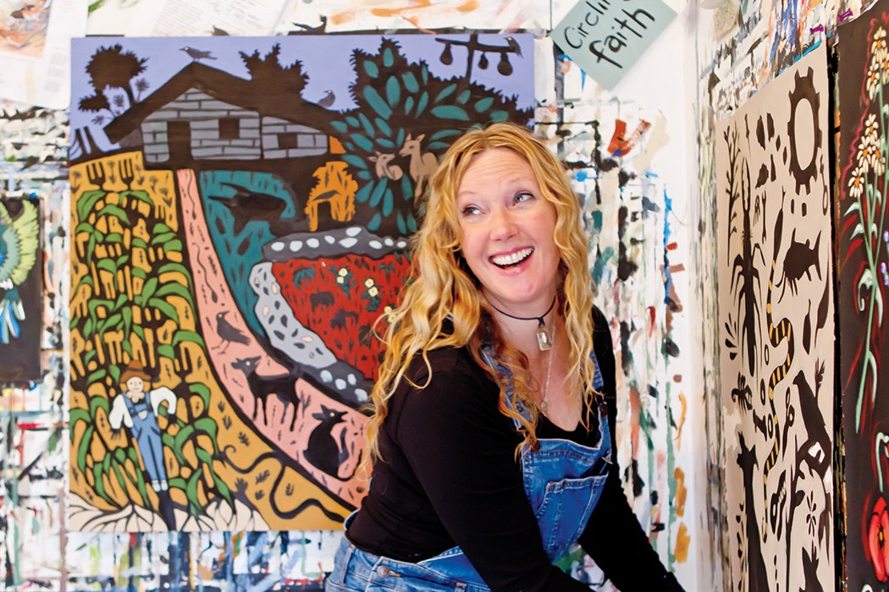
Bethanne Hill
American Painter

Slide 2
As a young girl, Bethanne Hill discovered Australian Aboriginal art and connected deeply with it. “It was like this immediate love,” she says of the art’s bold outlines and patterns and its imagery of mythology and storytelling. Hill appreciated the way Aboriginal art took license with changing perspectives. This freed her to try different approaches in her own art. Hill says she “came to understand painting as making one mark and then responding to it.” The resulting work is a beautiful melding of scenes from the rural South with the active, patterned images of primitive art. Leiper’s Creek Gallery owner Lisa Fox first encountered Hill’s work at the Blue Spiral in Asheville, North Carolina. Fox immediately connected with the paintings, partly due to fond memories of growing up on a farm. “Her imagery made me feel sentimental and at the same time made me laugh,” says Fox. The paintings were just what she’d been searching for to fill a niche at her gallery
From barns and animals to fence posts and rivers, the scenes in Hill’s paintings are unavoidably narrative. Yet she doesn’t set out to tell a particular story. Instead, she notes that she is a voracious reader, when she can stay awake long enough to read at the end of a busy day of painting and family life. She reads a lot of Southern writers as well as nonfiction and culture books. For a “quick minute” in high school she “thought about being a cultural anthropologist” until she realized anthropology was a science

Slide 3
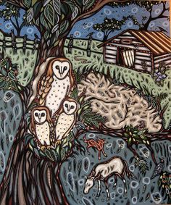
“When I paint,” she says, “that’s the closest I can get to writing a book, something I would love to do someday.” Hill takes bits and pieces from many different places and works them into a single painting. “The part I like is making them come together into one piece,” she says, smiling.

Slide 4
Compare and Contrast:
Aboriginal Art Work
Art work by Bethanne Hill

Slide 5
Step ONE:
Describe the Artwork
Identify the artist, title, date, etc.
Did the artist sign their piece?
What medium did the artist use?
What is the size/scale of the piece?
2) Identify the subject matter (trees, people, shoes, etc.)
Make a list of all the objects you see.

Slide 6
Step TWO:
Analyze
Use the vocabulary terms you know to analyze the work
(Elements and principles of design)
LINE SHAPE SPACE COLOR TEXTURE VALUE FORM
BALANCE EMPHASIS CONTRAST RHYTHM PATTERN
MOVEMENT VARIETY PROPORTION UNITY CONTRAST
FOREGROUND MIDDLEGROUND BACKGROUND
LANDSCAPE PORTRAIT ABSTRACT NON-REPRESENTATIONAL

Slide 7
Step THREE:
Interpretation
What do you think the artwork is about?
Why do you think that?
How does the artwork make you feel?
What does the artwork remind you of?
What style of art do you think it is and why?
****Use the information you collected from describing and analyzing the artwork.
You want to find out the meaning of the work and what the artist’s message is to the viewer.
You may interpret the artwork different from another viewer!

Slide 8
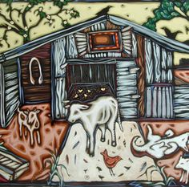
Step FOUR:
Judgement
This is your opinion!
Is the work successful?
Give reasons/evidence for your answer.
Do you think the work is well organized, be specific?
Do the elements of art and principles of design help convey
The message? How do they do that or why do they not.
Would you place this piece in your house? Why or why not.
****Be descriptive.

Slide 9
National Art Standards:
Create: Apply visual organizational strategies to design and produce a work of art, design,
or media that clearly communicates information and ideas
Create: Document early stages of the creative process visually and/or verbally
In traditional or new media
Create: Choose from a range of materials and methods of traditional and
contemporary artistic practices to plan works of art and design

Slide 10
Resources:
http://nashvillearts.com/wp-content/uploads/2010/02/NashvilleArtsMagazineFeb2010.pdf

