Slide 1
ARTIST TRADING CARDS

Slide 2
Agenda
Today I am...
Drawing in my sketchbook
Creating an artist trading card
So That I can...
Build on my drawing skills
Be creative
Share my work with others
I am successful When I....
Draw in my sketchbook for 7 min.
Create a unique artist trading card using the elements of art and principles of design

Slide 3
Essential Questions
How will you use your knowledge of the art elements and principles of design to create an aesthetically pleasing composition that you will share with a peer?
What will make your card unique?
What medium will you use to create your piece?

Slide 4
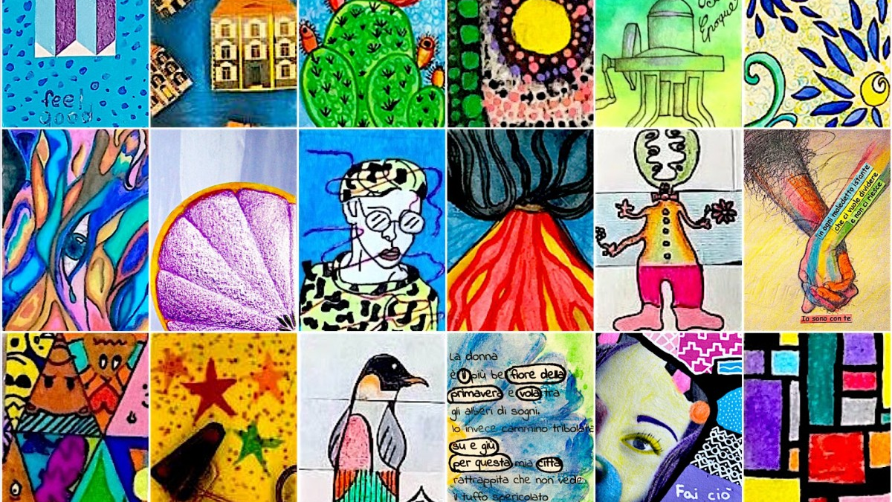

Slide 5
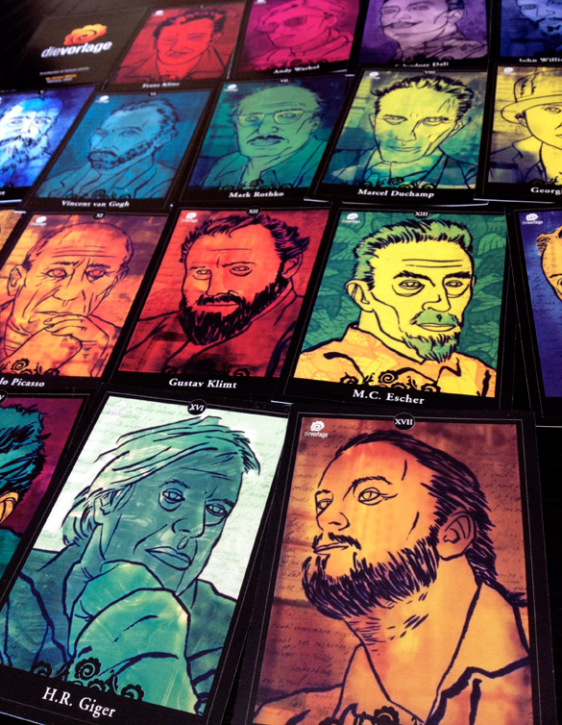
CHECKLIST
Your composition and subject matter is unique
You filled the space of your canvas
Your craftsmanship is neat
You have applied color
You have introduced yourself on the back of your card
You have written an inspirational quote....don't forget the citation

