Slide 1
Operation Proud Nation
How will you create a colorful artwork that expresses gratitude and appreciation for members of the U.S. military serving at home and around the world, using your knowledge of the elements of art and principles of design?

Slide 2
Did you know?
That the US military responds to people in distress
all over the world by providing
Humanitarian aide following natural disasters
Since 1973, the US military has been an entirely
“volunteer” military
That every person in the military counts on support
From their family, friends, and community while on active
duty

Slide 3
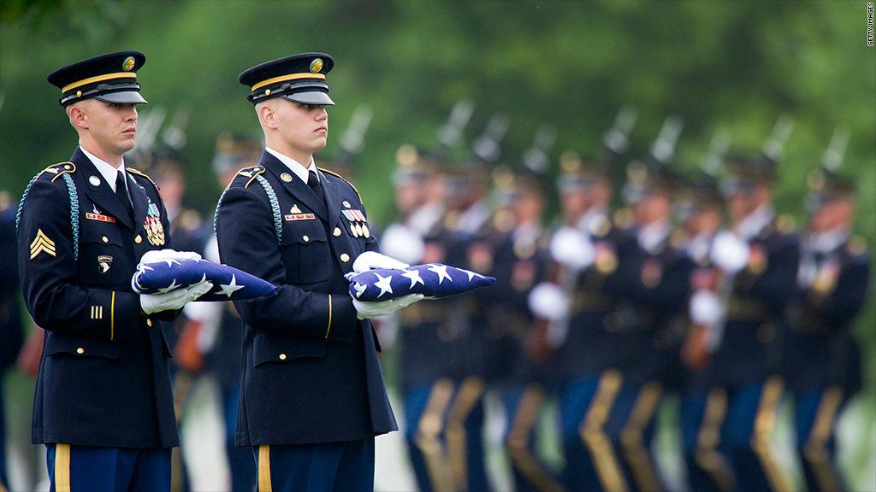

Slide 4
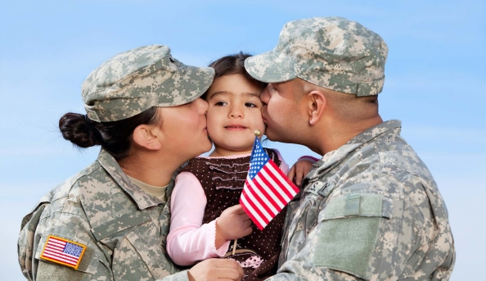
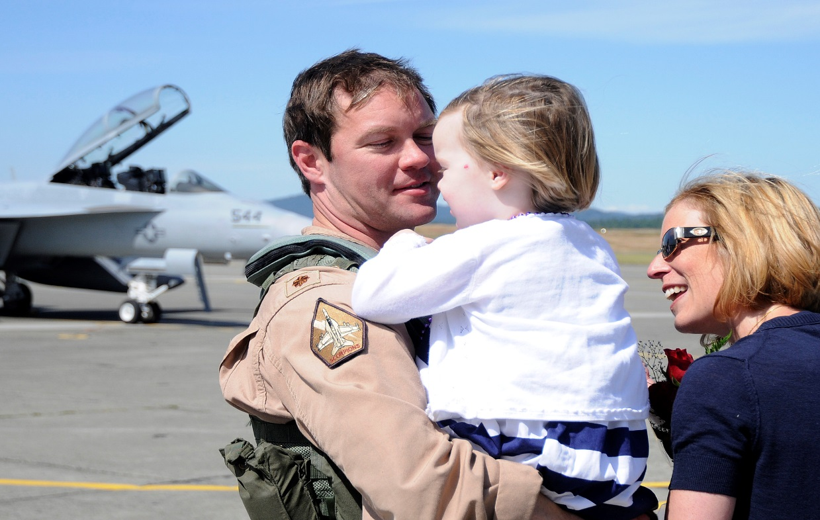
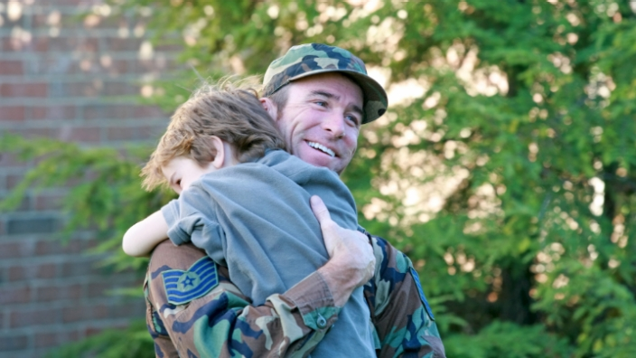

Slide 5
Did You know?
That approximately 20% of members of the active
Military are stationed outside the continental US
That on average a member of the military can expect to
Relocate every 3-6 years, while serving in the armed forces.
That over 50% of military members are married,
43% have children and there are 1.8 million children being
Raised in military families

Slide 6
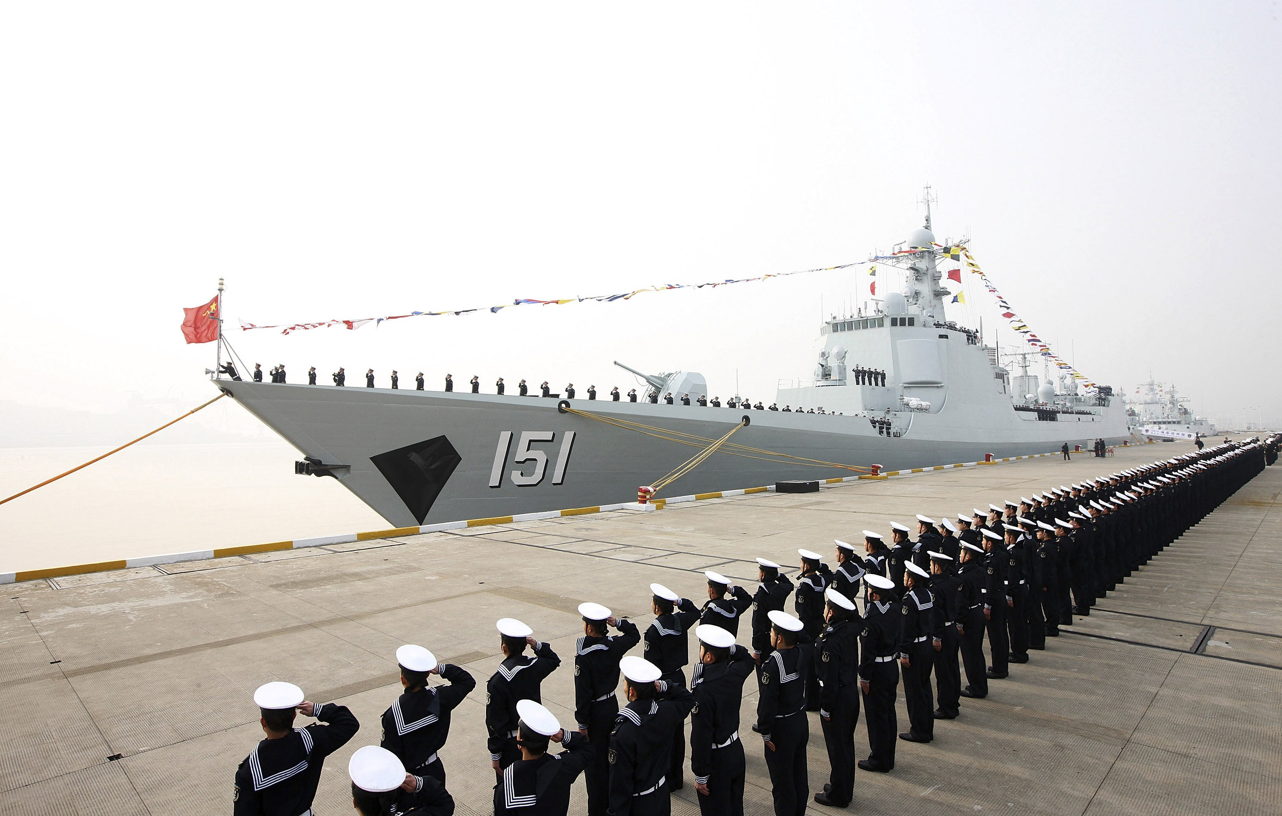

Slide 8
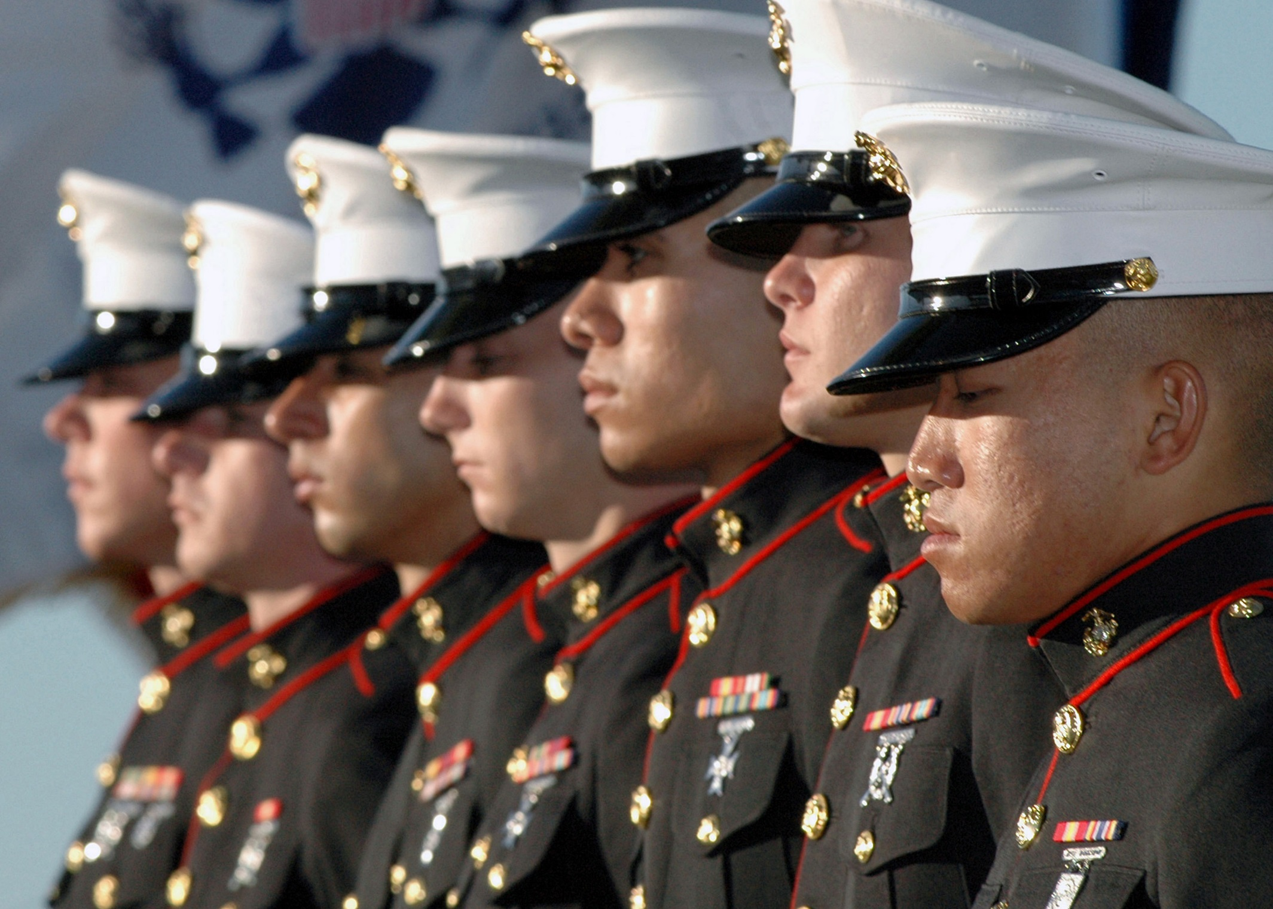
Marines

Slide 9
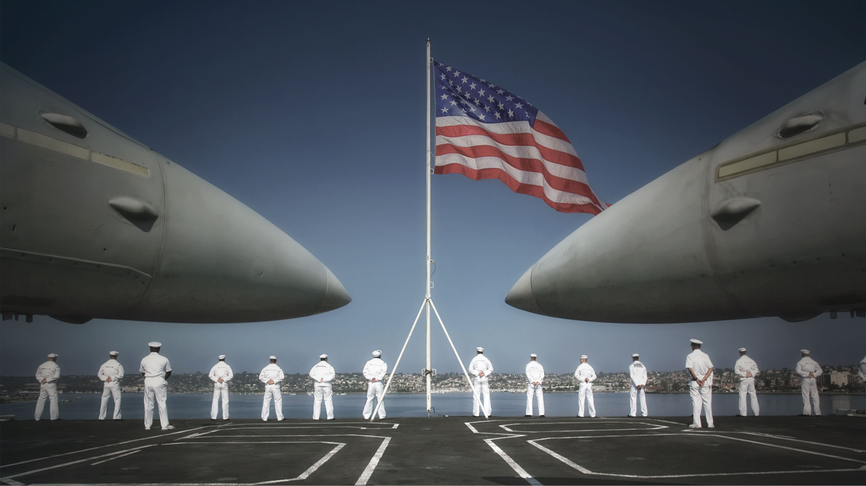
Navy

Slide 10
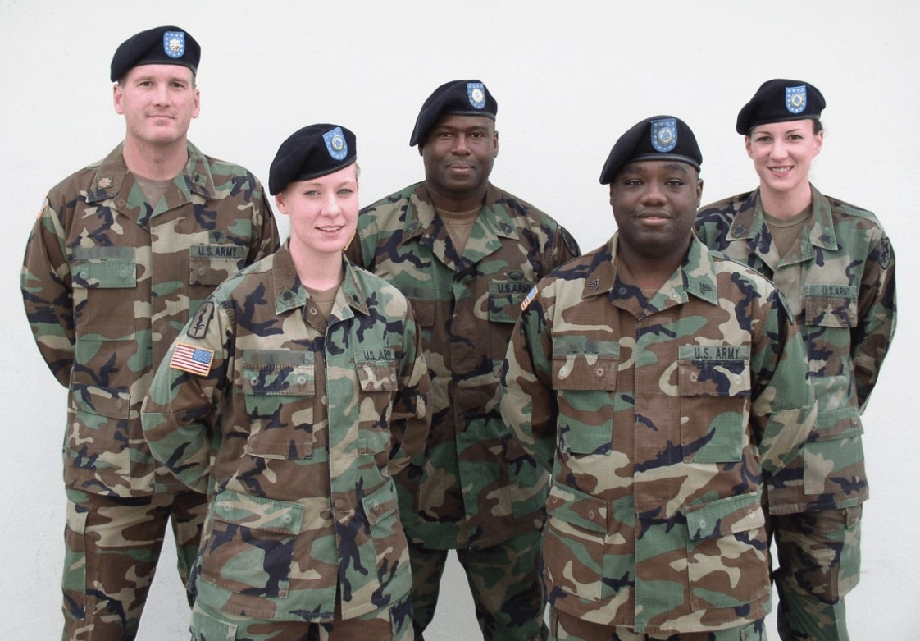
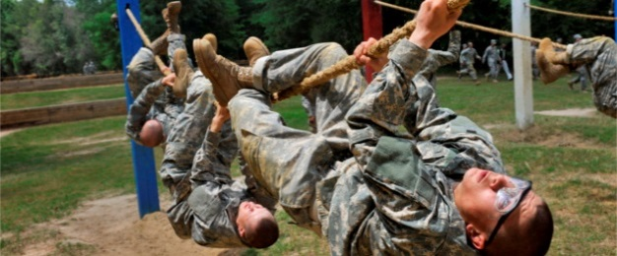
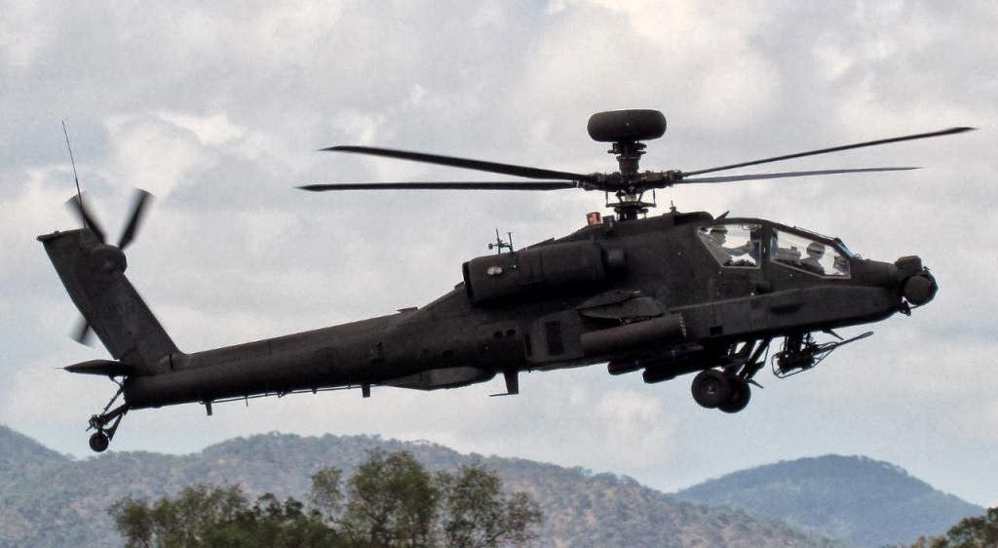
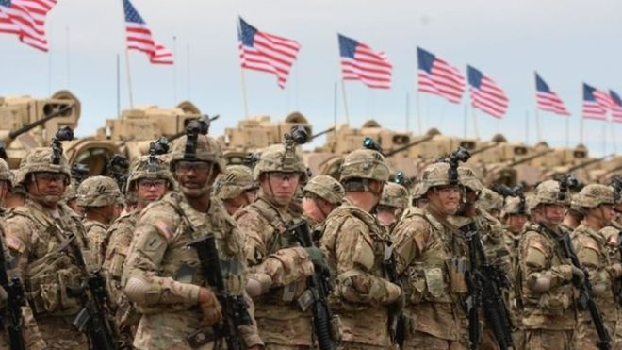
Army

Slide 11
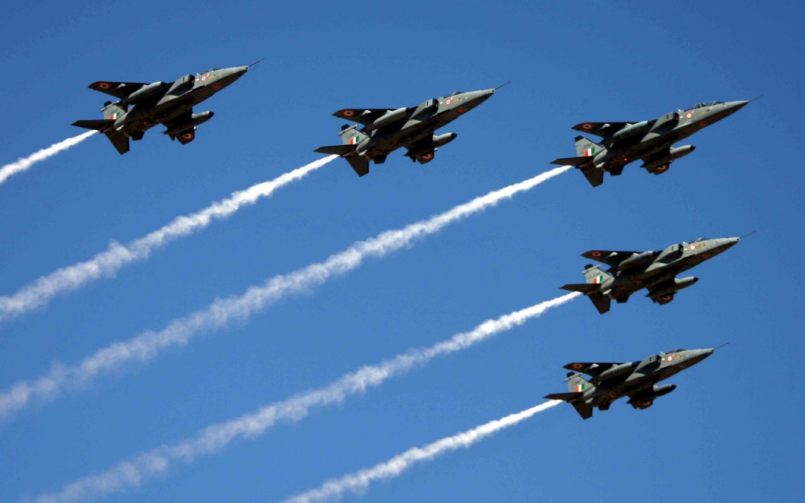

Slide 12
Ticket out the door!
What are some of the hardships associated with moving from one place to another
For the soldier?
For their husband or wife?
For their children?

Slide 13
Resources:

