Slide 1
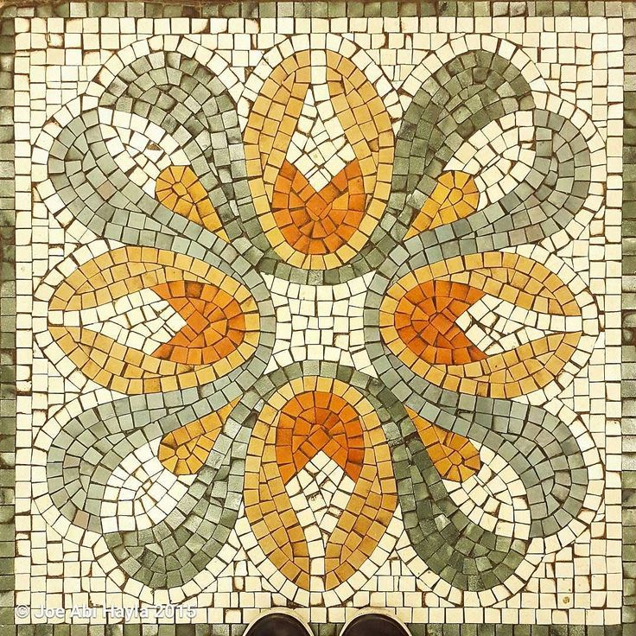
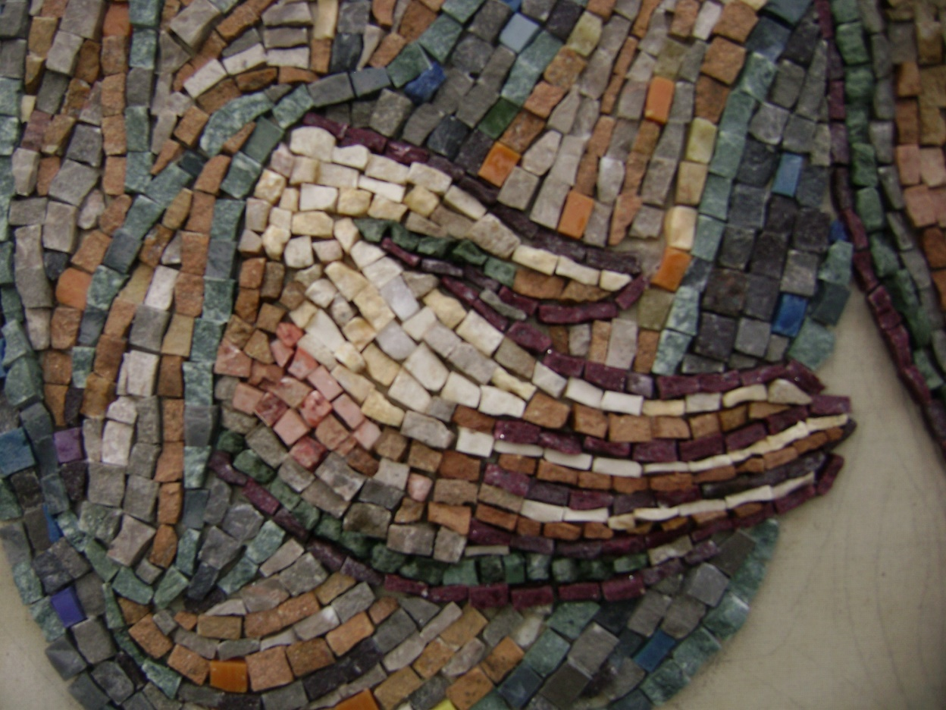
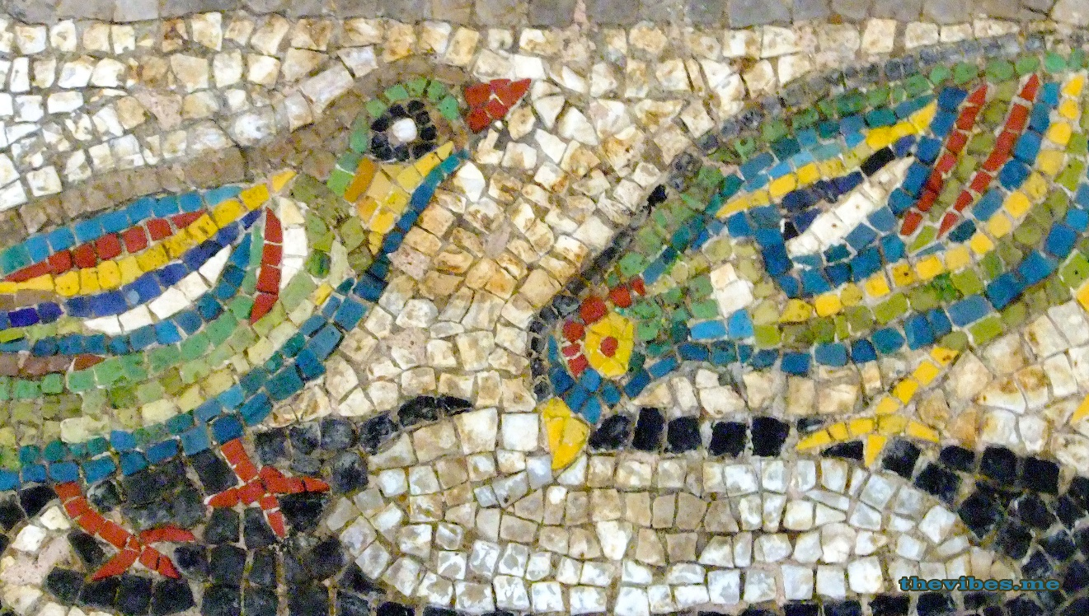
Mosaics
A mosaic is a piece of art or image made from the assemblage of small pieces of colored glass, stone, or other materials. Most mosaics are made of small, flat, roughly square, pieces of stone or glass of different colors, known as tesserae (Latin for cube).

Slide 2
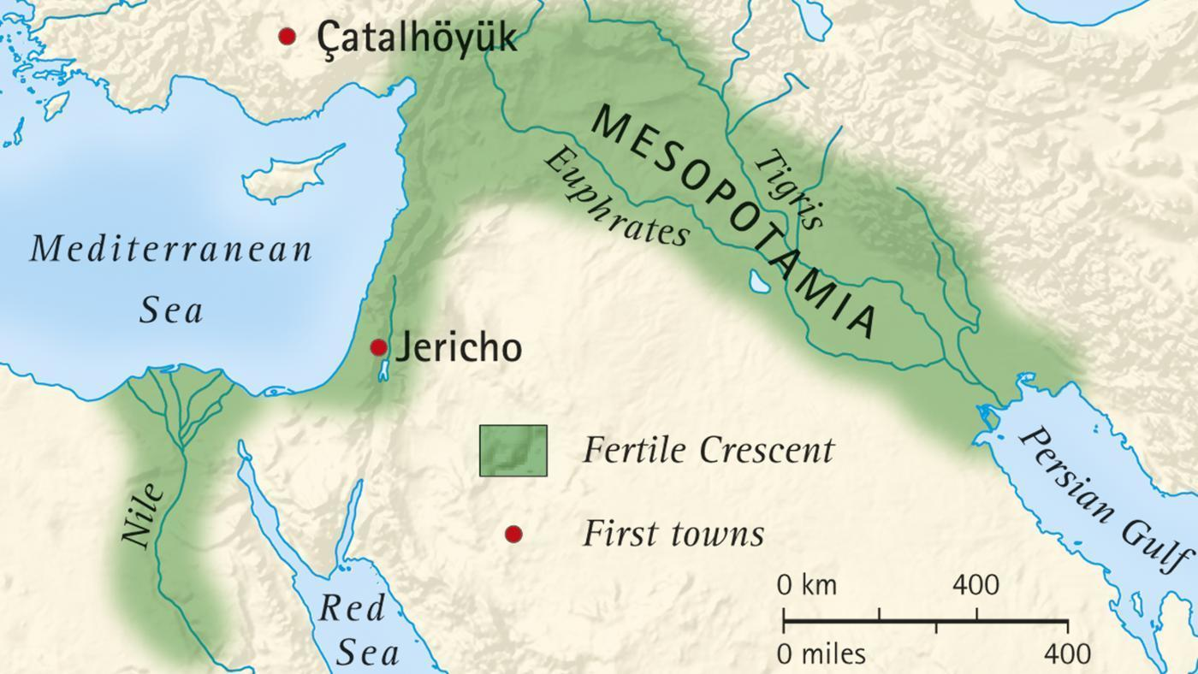
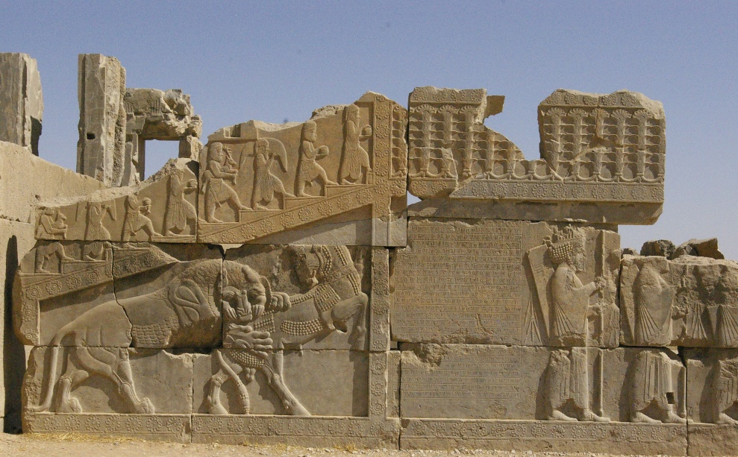
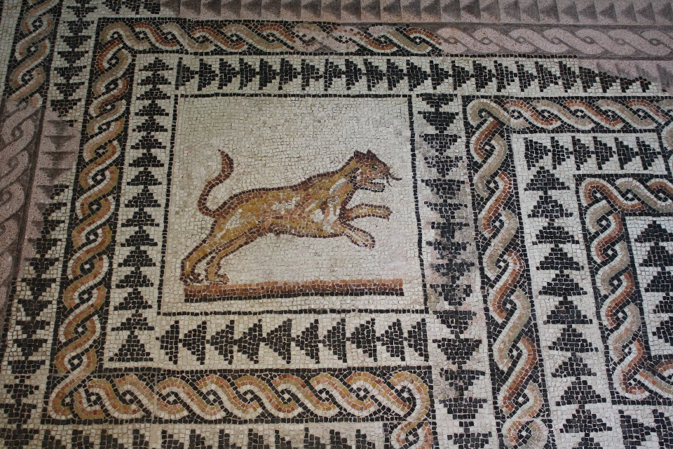
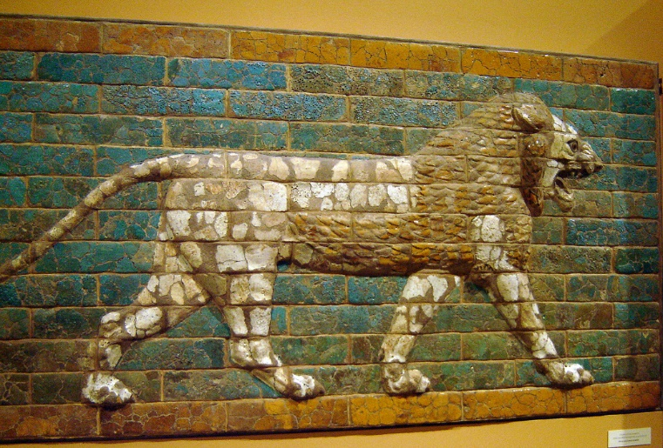
Where were the first Mosaics found?
Mesopotamia
(The Land Between
Two Rivers)

Slide 3
Functional Vs. Non-functional art
Functional ART-objects like tables and chairs, to beds, sofas, clocks, dressers, and even lighting fixtures.
Non-functional- serves no purpose but ornamentation

Slide 4
Are these pieces of art functional?
?
?

Slide 5
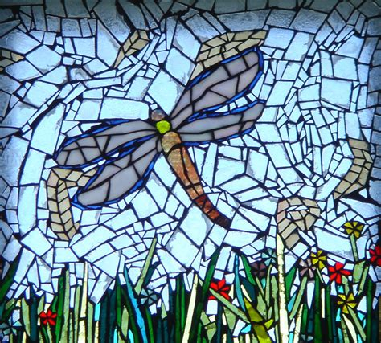
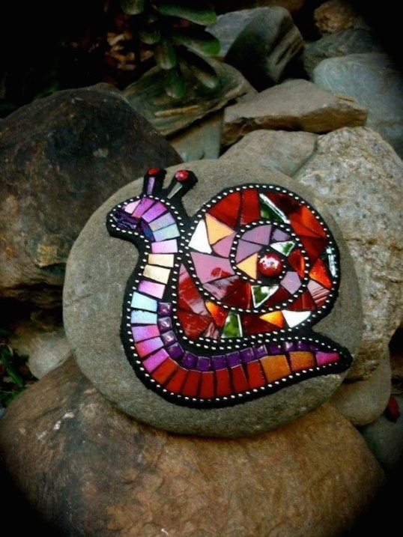
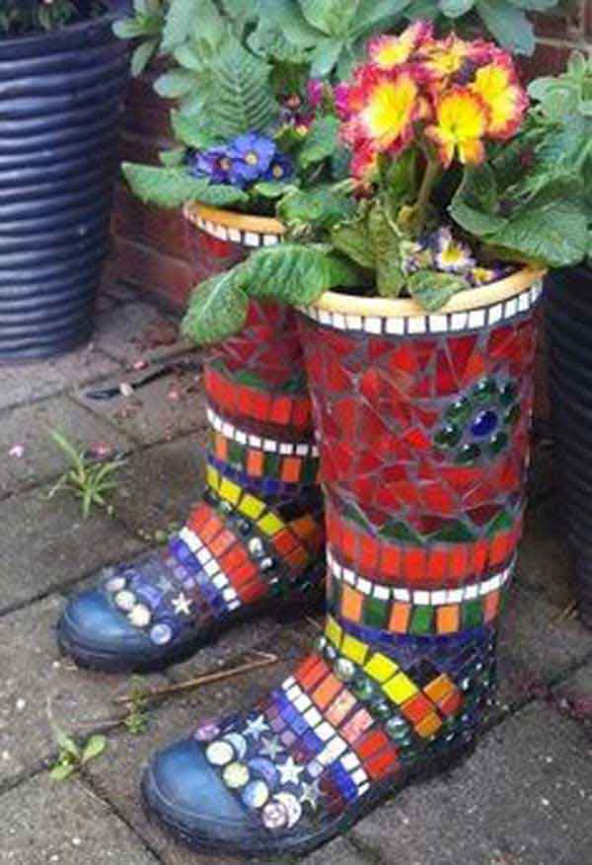
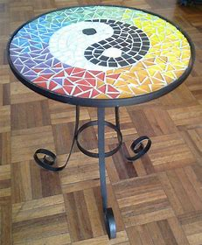
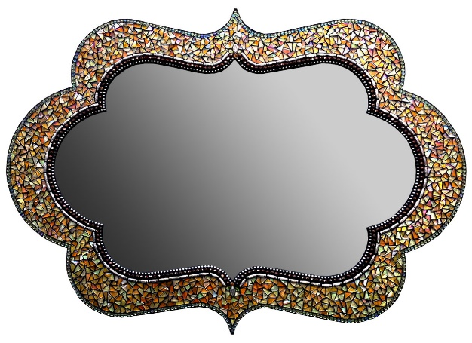
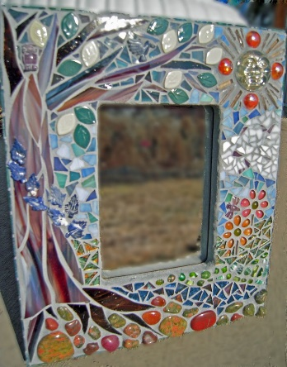
?????

Slide 6
Today’s Agenda
Today I am…
Completing my daily sketchbook drawing
Learning and discussing the difference between functional and non-functional art
Learning about MOSAICS
So That I can….
Develop my drawing skills
Identify functional and non-functional art
Create a mosaic
I am successful when I…..
Complete my sketchbook for the day
Create a mosaic using paint swatches and colored pencils

Slide 7
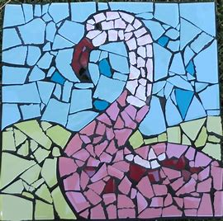
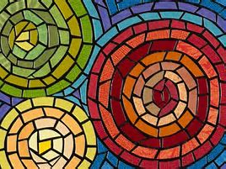
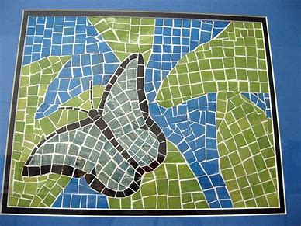
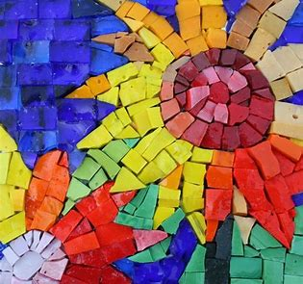
Criteria Checklist:
Create an aesthetically pleasing composition
Break edges of canvas
Make sure there is a GROUT SPACE in between each swatch piece
Be Creative!
Pay attention to CRAFTSMASHIP
EQ: How will you create a 2D non-functional mosaic that is aesthetically pleasing?

Slide 8
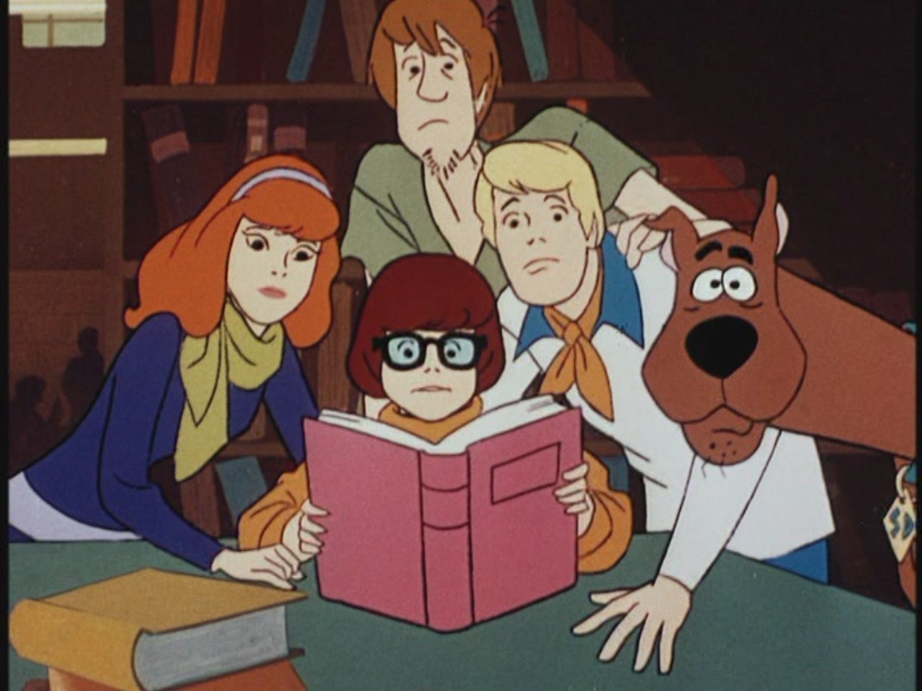
Sketchbook:
Draw part of the picture
Each day for 10 points
Image should be finished by
Friday!

