Slide 1
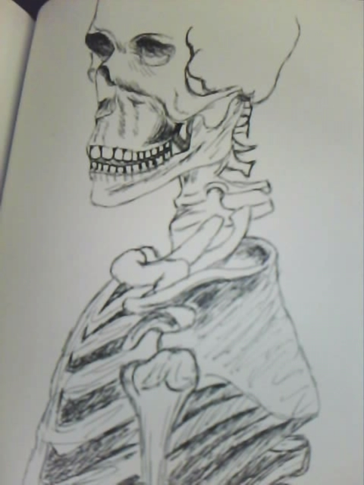
Skeletons and Skulls Unit
EQ:
How will you create a series of
2D artworks inspired by
Jose Guadalupe Posada and
Dia de los Muertos
“Day of the Dead?”
Artist: Ms. Bonadonna (Gaut)
Medium: Pen
Year: 2012

Slide 2
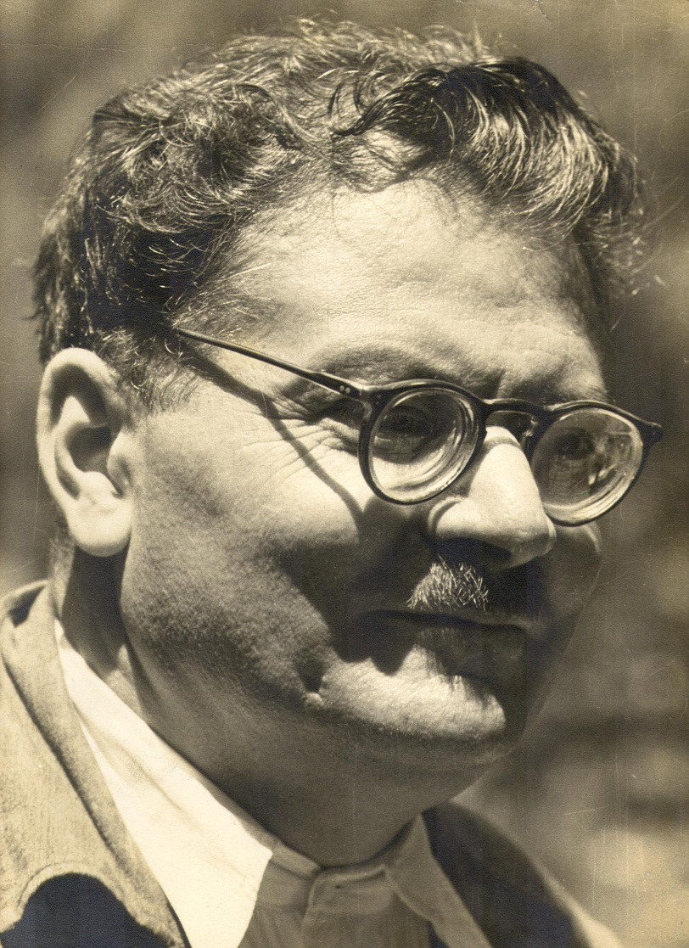
José Guadalupe Posada
Artist: Jose Guadalupe Posada (1851 - 1913) Nationality: Mexican Media/Style: Engraving, lithography, printmaking Biography: Jose Guadalupe Posada was a Mexican artist primarily concerned with political and social messages in his work. He often focused on the difficulties that the poor faced. After 1890, his Mexico City studio was converted into a store that sold Posada’s cartoons and illustrations.

Slide 3
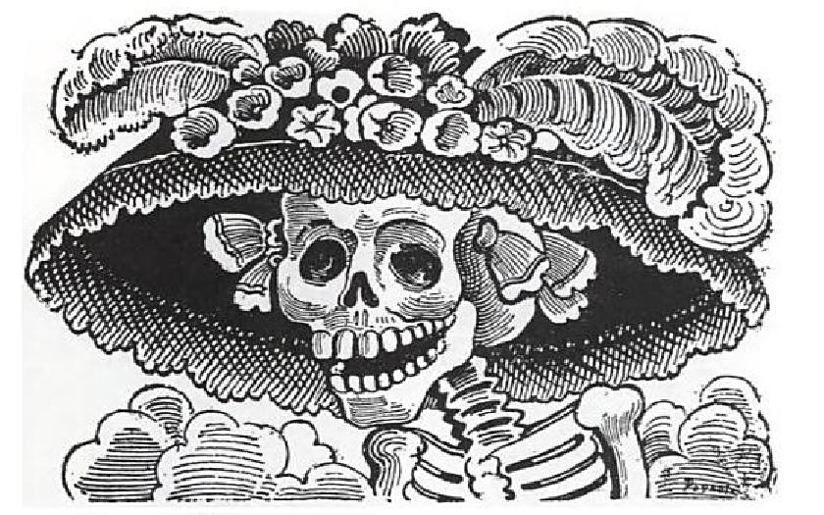
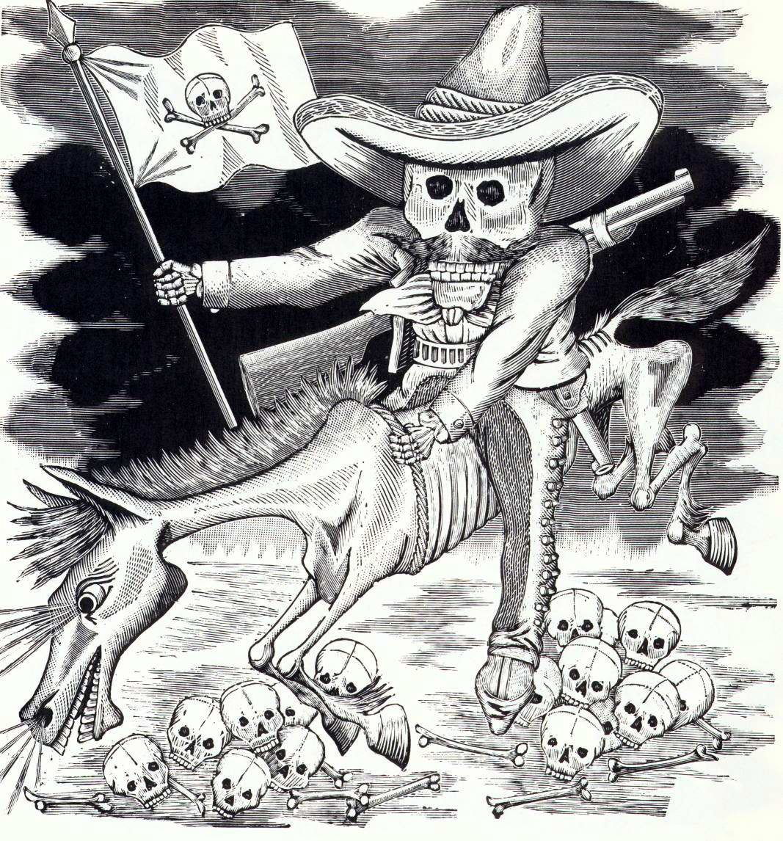
José Guadalupe Posada

Slide 4
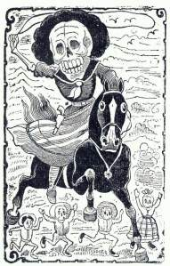
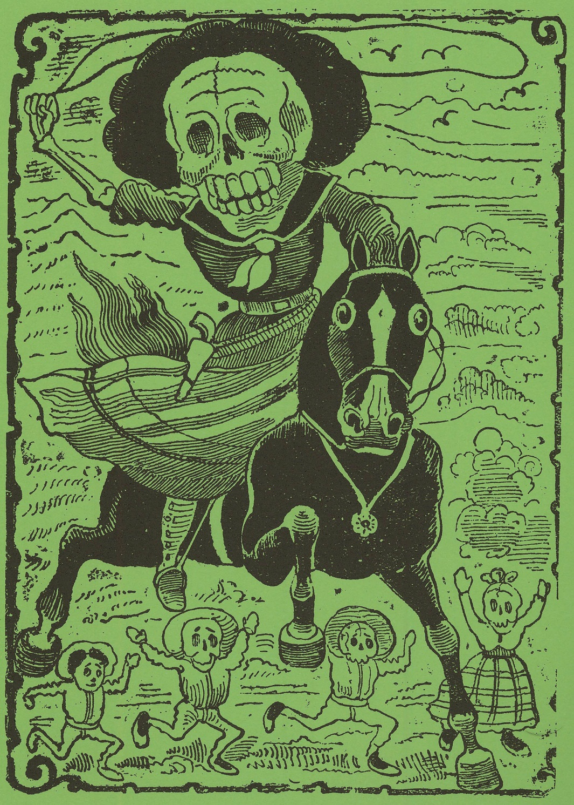

Slide 5
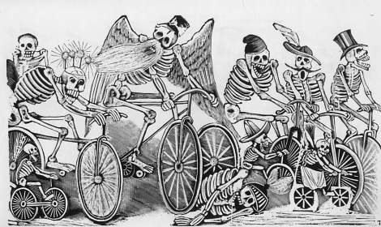

Slide 6
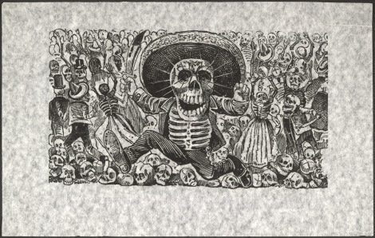

Slide 7
Vocabulary Terms:
A lithograph is a print made by drawing on limestone with wax crayons, applying ink onto the stone and printing the image onto paper.
Printmaking is a means of producing multiple images, each of these is called a print. Prints are created from a single original surface, known technically as a matrix or a plate. You can print off foam, gel plates, wood, and metal.

Slide 8
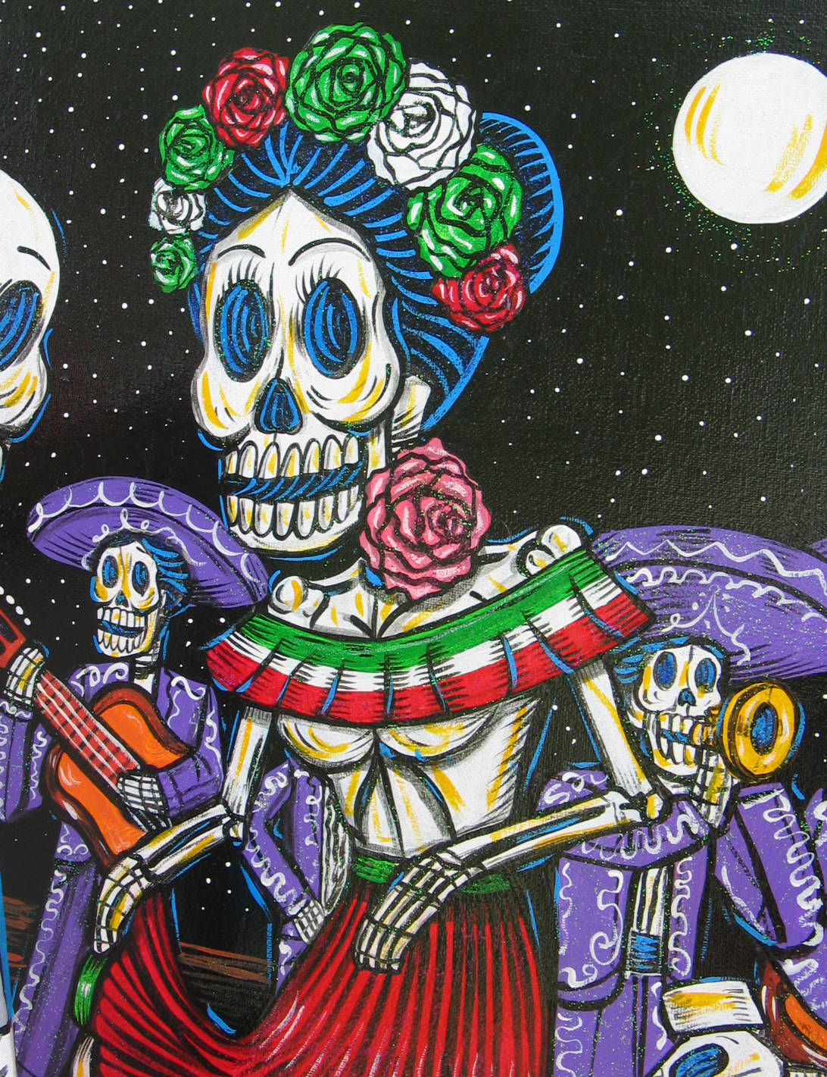
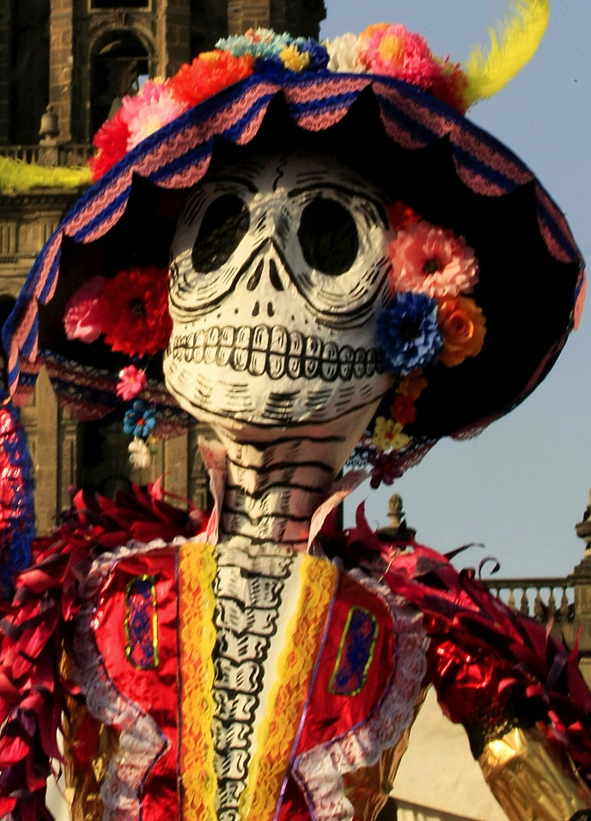
Day of The Dead
Mexican Holiday

Slide 9
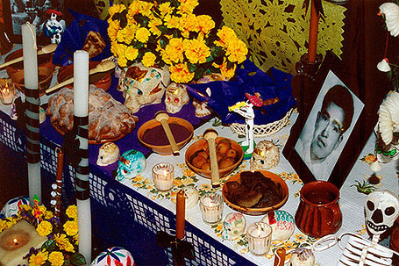
November 1st and 2nd

Slide 10
It originated in Mexico and Central America
Día de los Muertos originated in ancient Mesoamerica (Mexico and northern Central America) where indigenous groups, including Aztec, Maya and Toltec, had specific times when they commemorated their loved ones who had passed away. Certain months were dedicated to remembering the departed, based on whether the deceased was an adult or a child.
After the arrival of the Spanish, this ritual of commemorating the dead was intertwined with two Spanish holidays: All Saints Day (Nov. 1) and All Soul’s Day (Nov. 2). Día de los Muertos is often celebrated on Nov. 1 as a day to remember children who have passed away, and on Nov. 2 to honor adults.
Today, Día de los Muertos is celebrated mostly in Mexico and some parts of Central and South America. Recently it has become increasingly popular among Latino communities abroad, including in the United States.

Slide 11
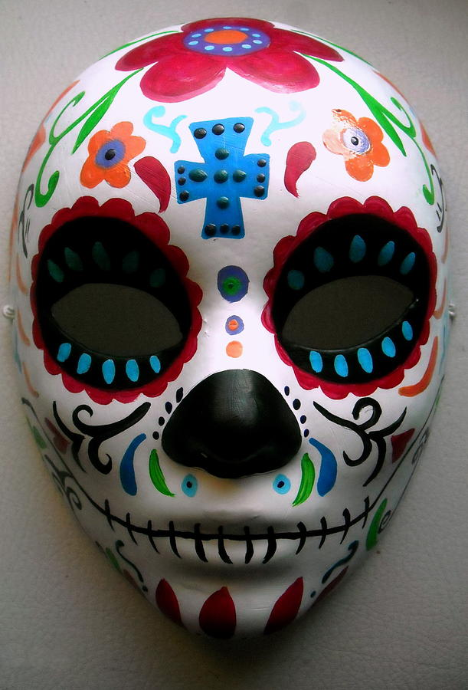
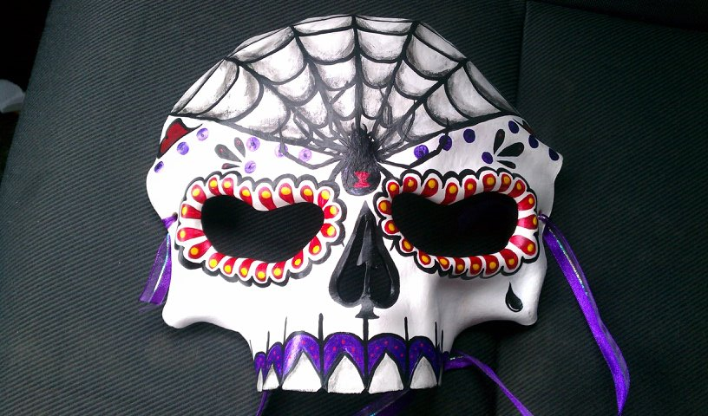
Family and friends gather together in
Celebration to remember the
Special people in their lives that have
Passed on.
Decoration include:
Masks
Skulls
Alters
Food
Candles
Flowers

Slide 12
It’s a celebration of life, not death

Slide 13
Ancient Mesoamericans believed that death was part of the journey of life. Rather than death ending life, they believed that new life came from death.
Día de los Muertos is an opportunity to remember and celebrate the lives of departed loved ones. Like any other celebration, Día de los Muertos is filled with music and dancing. Some popular dances include La Danza de los Viejitos—the dance of the little old men—in which boys and young men dress as old men, walk around crouched over then suddenly jump up in an energetic dance. Another dance is La Danza de los Tecuanes–the dance of the jaguars–that depicts farm workers hunting a jaguar.
http://insider.si.edu/2016/10/5-facts-dia-de-los-muertos-day-dead/

Slide 14
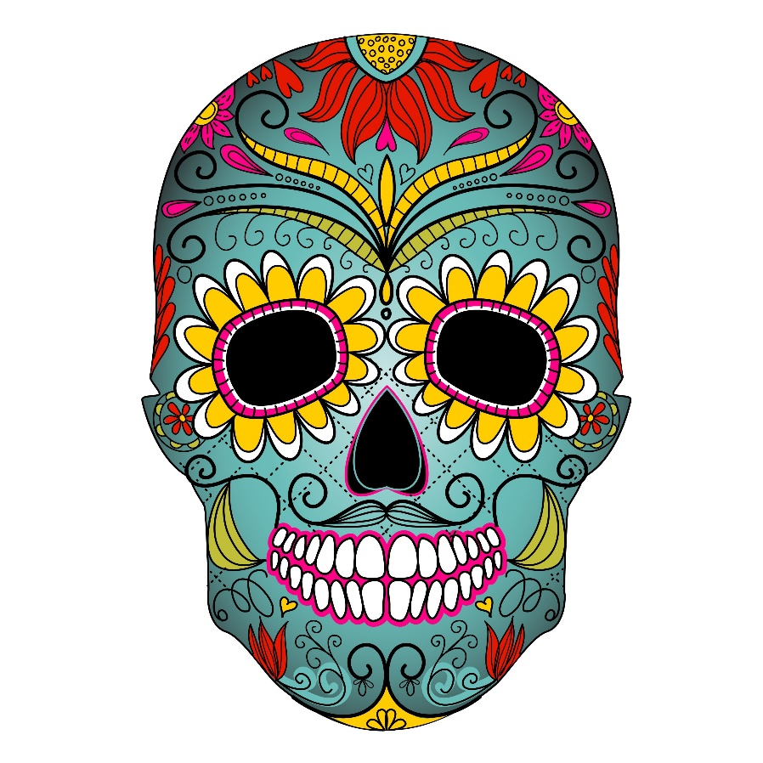
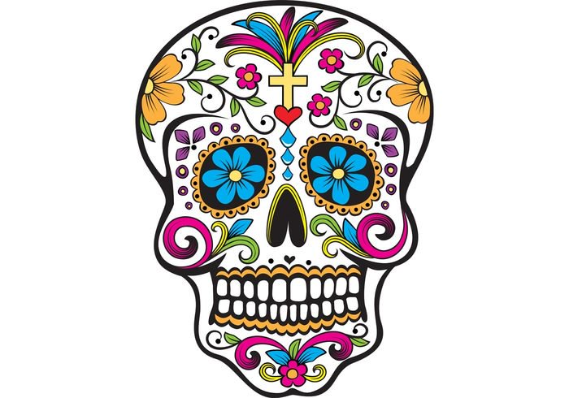
Create UNITY by repeating line designs, shapes, images, and colors.
Your design may be SYMMETRCIAL or ASYMMETRICAL.
Take your time and watch your CRAFTSMANSHIP ☺

