Slide 1
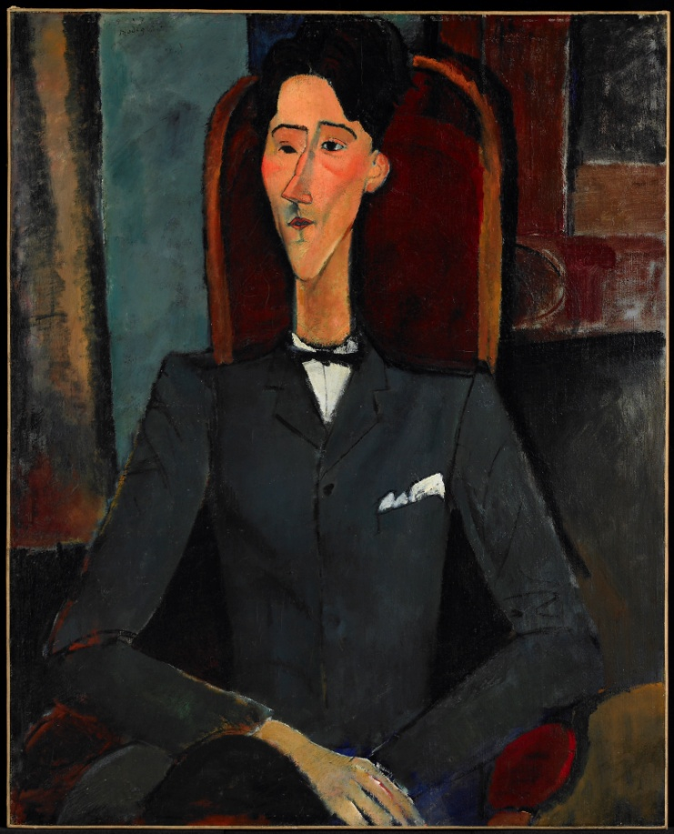
Abstraction in Portraiture Cézanne and the Modern

Slide 2
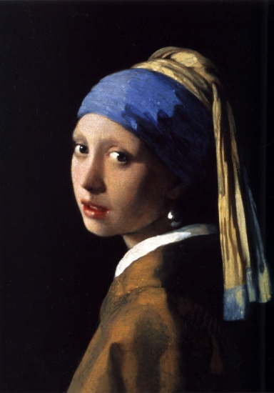
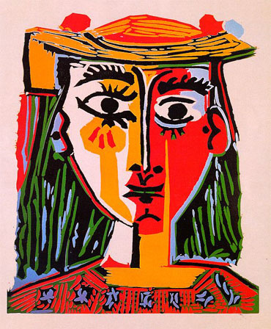
Realistic vs. Abstract
Realistic:
Artwork that seeks to represent the subject how it looks in real-life
“Girl with a Pearl Earring” Johannes Vermeer: 1665
Abstract:
Artwork that that shows the effect of reality through shapes, forms, colors, and textures.
“Bust of a Woman with a Hat” Pablo Picasso: 1962

Slide 3
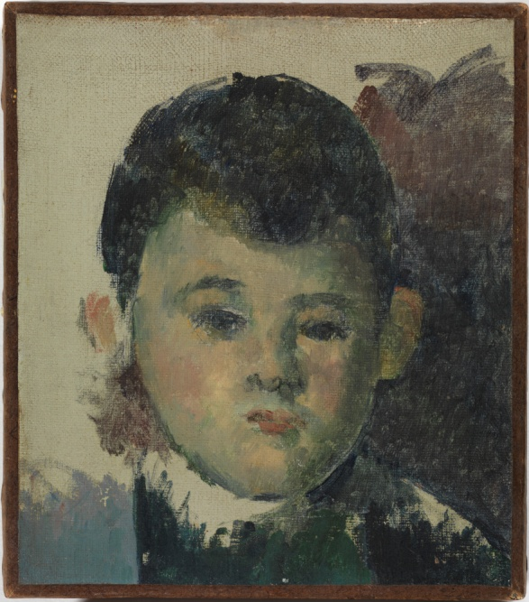
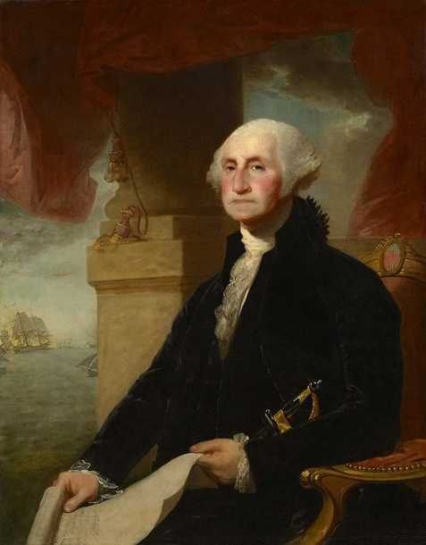
What is a portrait? Why do artists create them?
Portrait: A painting, photograph, sculpture, or other artistic representation of a person, where the face and its expression are the focus.
Artists will create portraits to show the physical characteristics, personality, and even mood of the subject.
-These can be important people in the artist’s life, or important people in society.
Commission: The hiring and payment to an artist for the creation of a piece.
-Artwork may be commissioned by private individuals, the government, or specific businesses.
George Washington after the Battle of Princeton January 3, 1777, Charles Willson Peale
Portrait of Paul, the Artist’s Son
Paul Cezanne, 1880

Slide 4
Jean Cocteau : Amedeo Modigliani : 1917
Is this painting abstract or realistic?
Who do you think this man is?
What do you think he does for a living? Why?

Slide 5
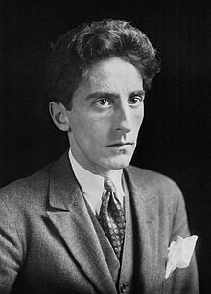
Jean Cocteau the man vs. Jean Cocteau the painting
Jean Cocteau was a French poet, novelist, dramatist, designer, playwright, artist and filmmaker during the 20th century. The artist Amedeo Modigliani and Jean were friends when Amedeo painted Jean.
Cocteau did not like his portrait, saying “It does not look like me, but it does look like Modigliani, which is better.”
How does Jean Cocteau look different in his painted version?

Slide 6
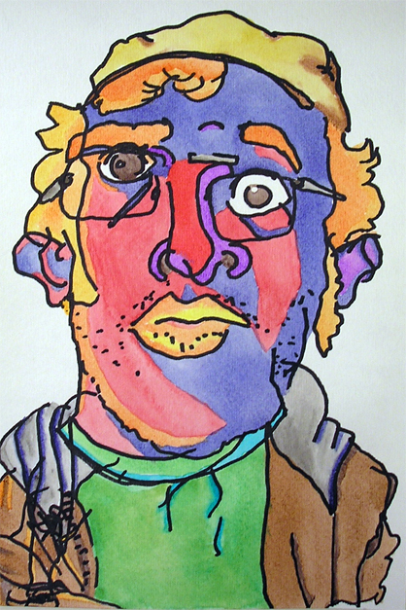
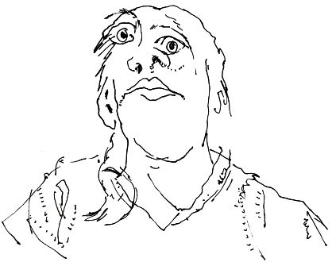
Blind Contour Portraits
Draw without looking
At your paper

Slide 7
Telling your portrait’s story
Who is in your portrait? What are they feeling? What do they do for a living? How can you show this?
Color Meaning:
Red: Red is the color of fire, energy, danger, strength, power, as well as passion, desire, and love.
Pink: signifies romance, love, friendship, feminine qualities and passiveness.
Orange: joy, sunshine, enthusiasm, fascination, happiness, and creativity
Yellow: joy, happiness, intellect, and energy
Dull (dingy) yellow represents caution, decay, sickness, and jealousy.
Light yellow is associated with intellect, freshness, and joy.
Green: growth, harmony, freshness, and nature.
Dark green is associated with ambition, greed, and jealousy.
Yellow-green can indicate sickness, cowardice, discord, and jealousy
Purple: royalty, power, nobility, luxury, and ambition.
Blue: trust, loyalty, wisdom, confidence, intelligence, faith, truth, and heaven.
Light blue is associated with health, healing, tranquility, understanding, and softness
Dark blue represents knowledge, power, integrity, and seriousness.
Brown: stability and denotes masculine qualities
Black : power, elegance, formality, death, evil, and mystery.
White: light, goodness, innocence, purity, the color of perfection

Slide 8
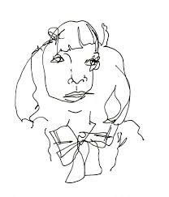

Slide 9
