Slide 1
Today I am…..
Drawing in my sketchbook
Watching and discussing a Brain Pop video on COLOR
Creating Preliminary sketches of color wheels
So That I can…..
Develop and build on my drawing skills
Know and understand color theory
Visualize and generate ideas for creating works of art
I am successful When I…..
Draw in my sketchbook for 7 minutes
Listen, Learn, and Discuss Color Theory
Generate ideas for my color wheel
DAY 1

Slide 2
Today I am…..
Drawing in my sketchbook
Reviewing color theory
Adding vocab terms to my sketchbook
Drawing and producing my color wheel
So That I can…..
Develop and build on my drawing skills
Know and understand color theory
Create a color wheel
Mix and make colors using ONLY the PRIMARY COLORS
I am successful When I…..
Draw in my sketchbook for 7 minutes
Listen, Learn, and Discuss Color Theory
Create a color wheel with 12 colors using only the 3 primary colors as the foundation
Day 2 & 3

Slide 3
Today I am…..
Drawing in my sketchbook
Discussing the importance of complementary colors
Creating preliminary sketches of animals
So That I can…..
Develop and build on my drawing skills
Know and understand color theory
Visualize and generate ideas for creating works of art
I am successful When I…..
Draw in my sketchbook for 7 minutes
Listen, Learn, and Discuss Color Theory
Generate ideas for my COMPLEMENTARY COLORED animal portrait
Day 4

Slide 4
DAY 5 & 8
Today I am…..
Drawing in my sketchbook
Discussing the importance of complementary colors
Producing complementary colored animal portraits
So That I can…..
Develop and build on my drawing skills
Know and understand color theory
Produce artwork using the elements and principles of design
Mix and create VALUES of color
I am successful When I…..
Draw in my sketchbook for 7 minutes
Listen, Learn, and Discuss Color Theory
Produce a COMPLEMENTARY COLORED animal portrait by mixing paint and creating value and different intensities of a hue

Slide 5
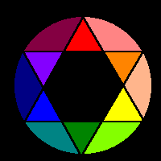
Color Theory

Slide 6
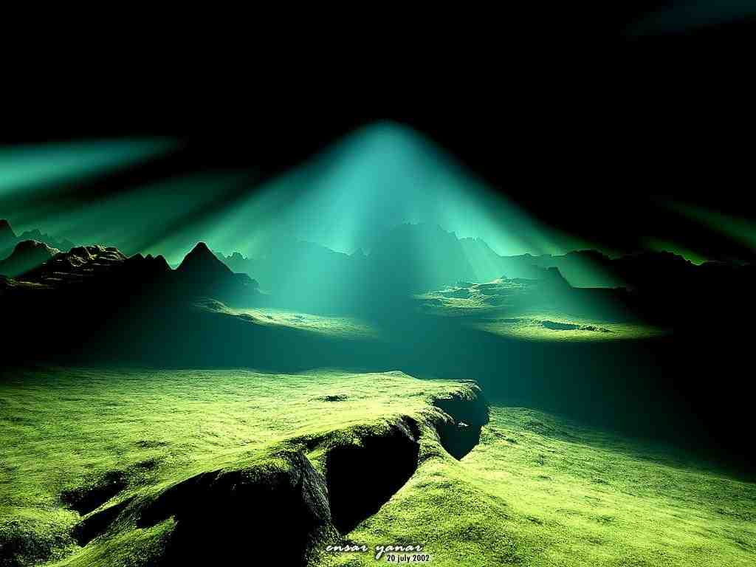
What is
Color?
Definition:(noun) - Color is the element of art that is produced when light, striking an object, is reflected back to the eye.
Image Credits
http://goodwlpaper.info/wp-content/uploads/2011/11/light-in-the-darkness.jpg

Slide 7
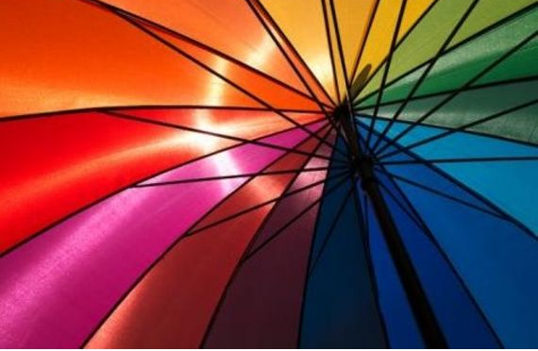
There are three (3) properties OF color

Slide 8
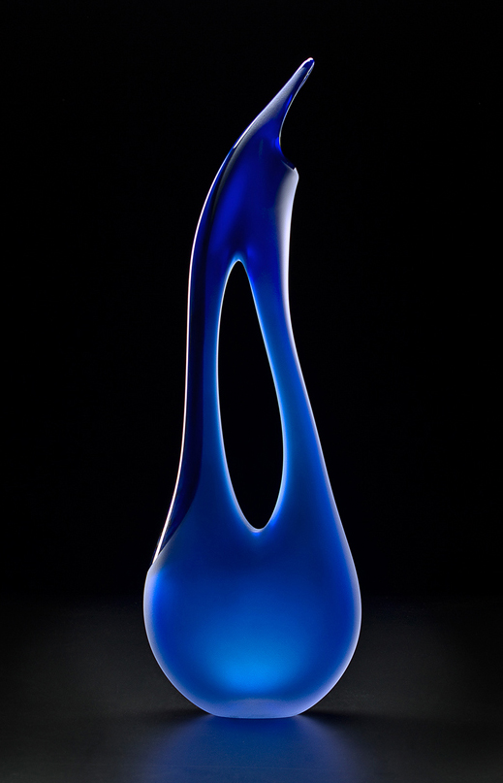
1⁻ First is hue
which simply means the name we give to a color (red, yellow, blue, etc.)
YELLOW
Blue

Slide 9
2⁻ the second property is Intensity
which refers to the strength and vividness of the color. For example, we may describe the color blue as "royal" (bright, rich, vibrant) or "dull" (grayed).

Slide 10
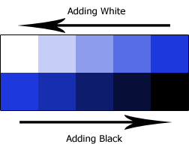
3⁻ the third and final property of color is its Value
meaning its lightness or darkness. The terms shade and tint are in reference to value changes in colors.
TINT=Adding White to your Hue SHADE=Adding Black to your hue
Sources: http://arthistory.about.com/cs/glossaries/g/c_color.htm

Slide 11
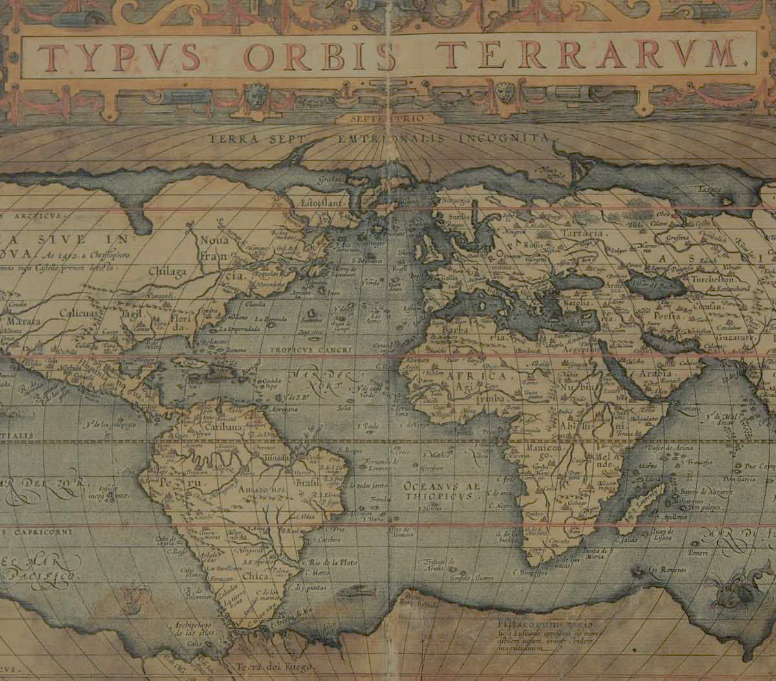
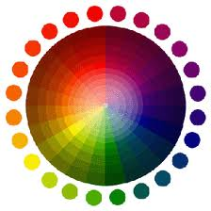
Let’s take a look back in….
History
Who discovered the first color wheel in history?
https://www.brainpop.com/artsandmusic/artconcepts/color/

Slide 12
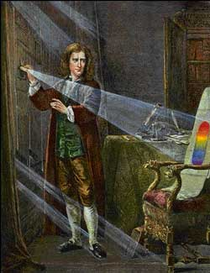
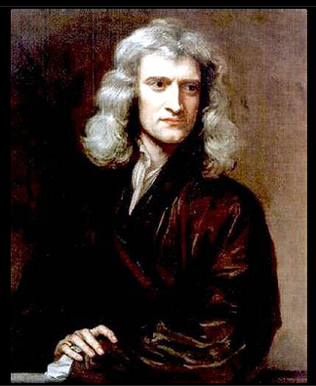
Sir Isaac Newton
https://www.brainpop.com/science/famousscientists/isaacnewton/
discovered the Spectrum
(1st color wheel) in 1670
How?

Slide 13
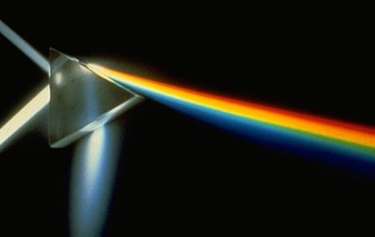
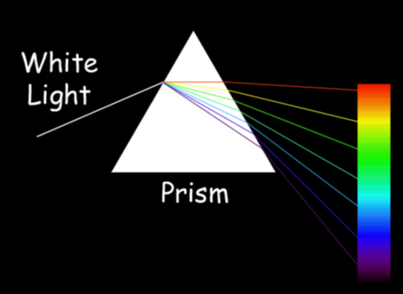
Spectrum: the separation of visible light bent in different bands of color
Spectrum

Slide 14
Where can we find the spectrum/color wheel in nature or environment?

Slide 15
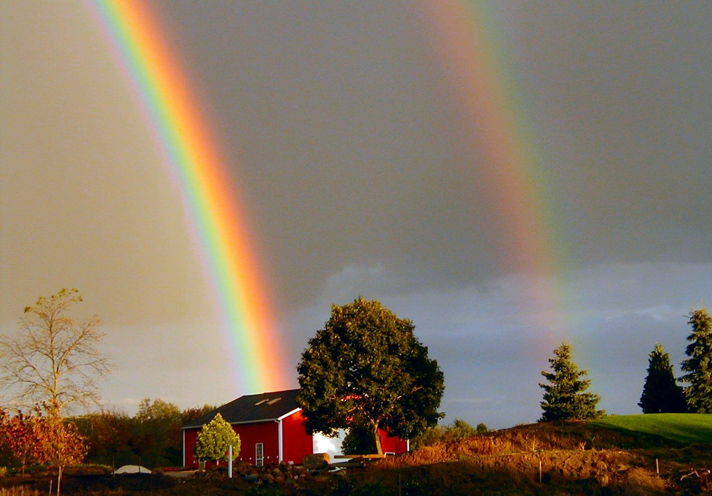
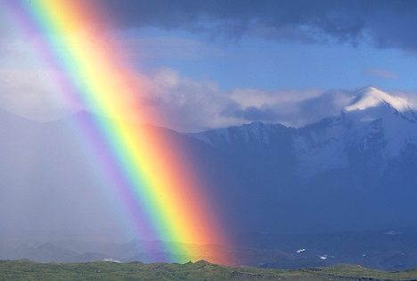
https://www.brainpop.com/science/energy/rainbows/

Slide 16
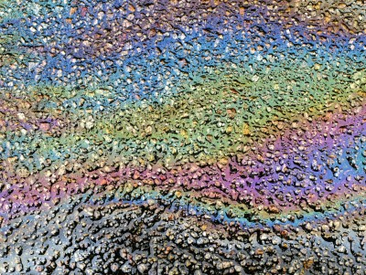
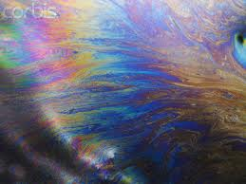

Slide 17
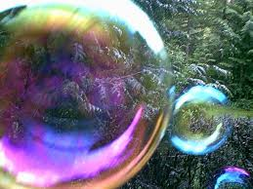
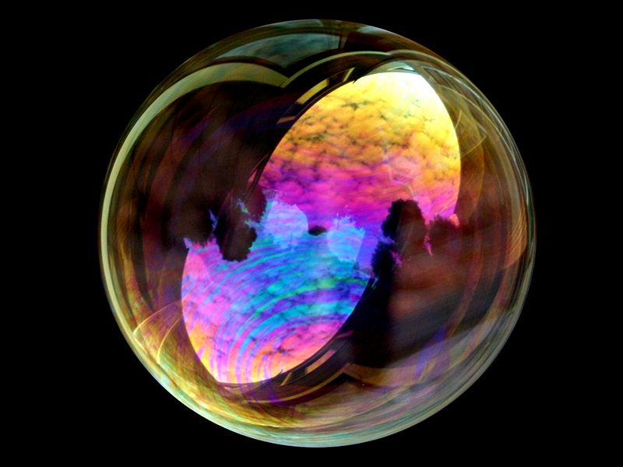

Slide 18
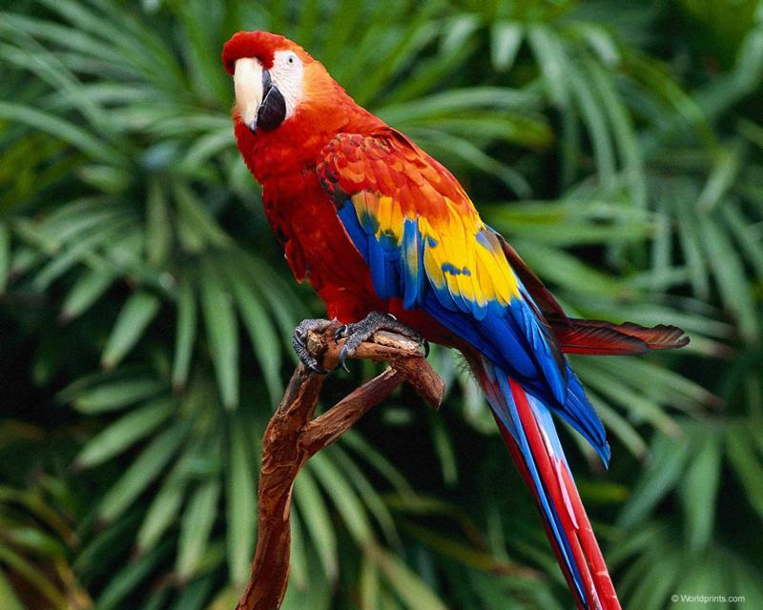
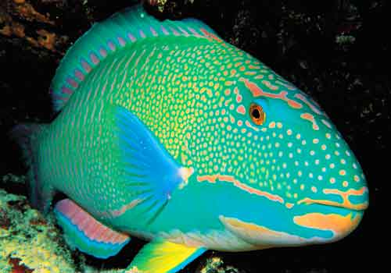
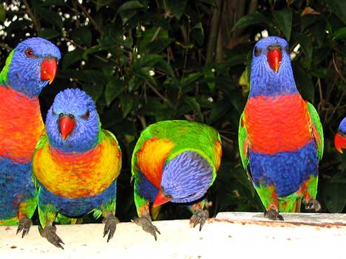
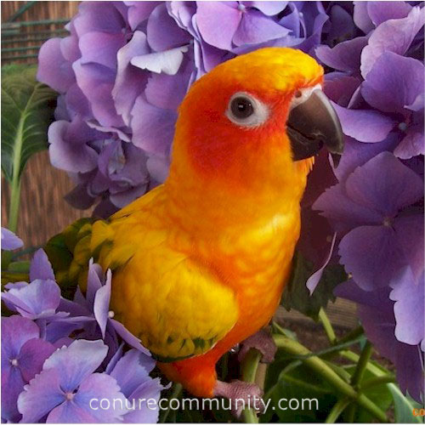

Slide 19
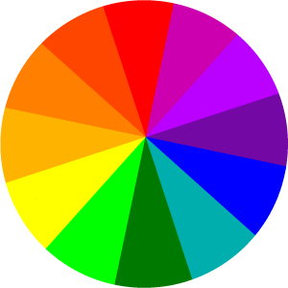
The Color Wheel
The color wheel fits together like a puzzle - each color in a specific place. Being familiar with the
color wheel not only helps you mix colors when painting, but in adding color to all your art creations.

Slide 20
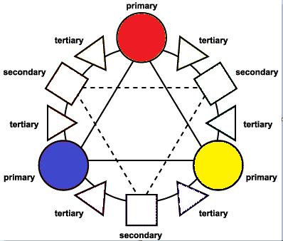
Primary Colors
Primary colors are not mixed from other elements and they generate all other colors.
Red
Yellow
Blue

Slide 21
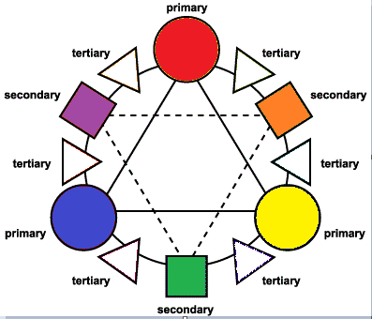
Secondary Colors
By mixing two primary colors, a secondary color is created.
Red + Yellow = Orange
Yellow + Blue = Green
Blue + Red = Purple

Slide 22
Tertiary Colors
Intermediate, or Tertiary, colors are created by mixing a primary and a secondary.
red-orange
yellow-orange
yellow-green
blue-green
blue-purple
red-purple

Slide 23
We have a problem!
You must have 12 colors in total
In order to make a color wheel
At the moment we only have 3 colors
Can you create the other 9 colors?
Let’s find out!

Slide 24
What Happens when you mix primary colors?
Mix primary colors and the
New color will be placed in
The square shape where it says
Secondary. *Only in the square
That is in between those two colors
mixed
?

Slide 25
How do you create a tertiary color?

Slide 26
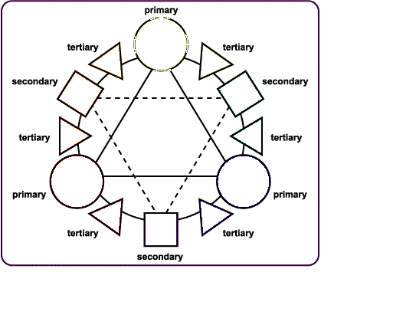

Slide 27
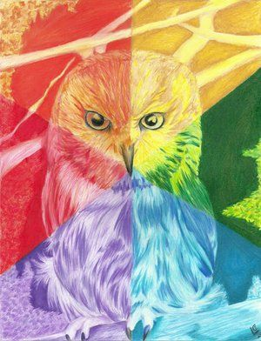
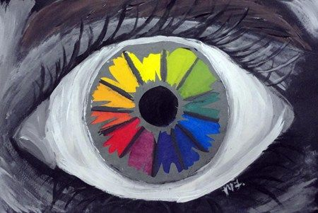
Design and paint your own color wheel
1.) BE CREATIVE (no simple circles or shapes)
2.) Draw your design in pencil first
3.) Make sure you have all 12 colors
4.) You have one week to create your design

Slide 28
WE DID IT!!
Now we have 12 colors

Slide 29
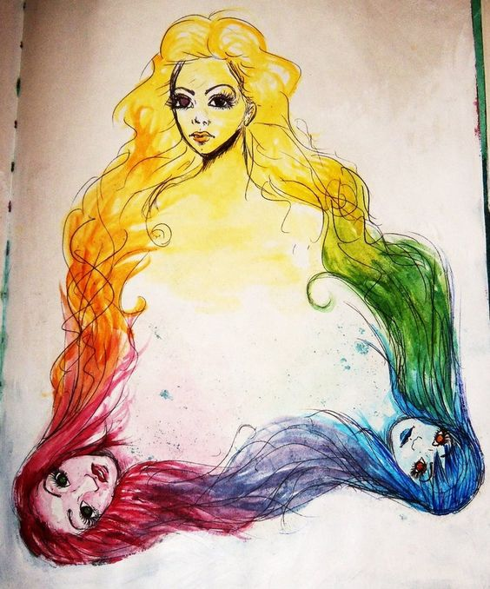

Slide 31
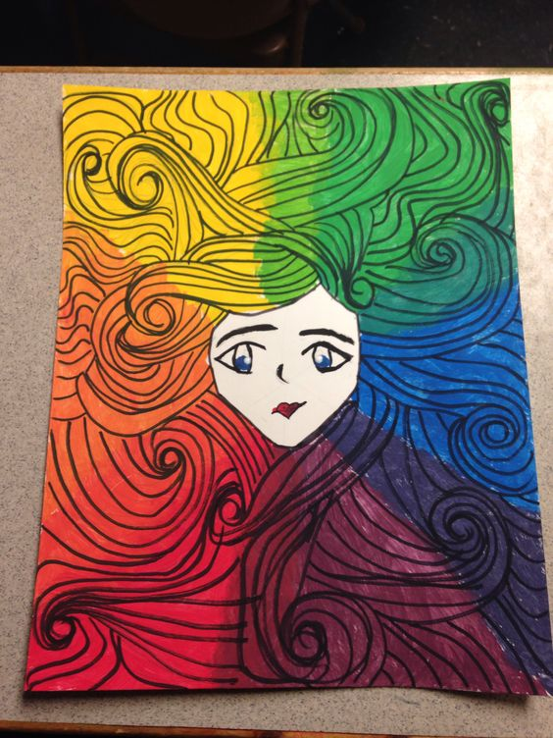
Critique this piece
DESCRIBE
ANAYLZE
INTERPRET
JUDGE

Slide 32
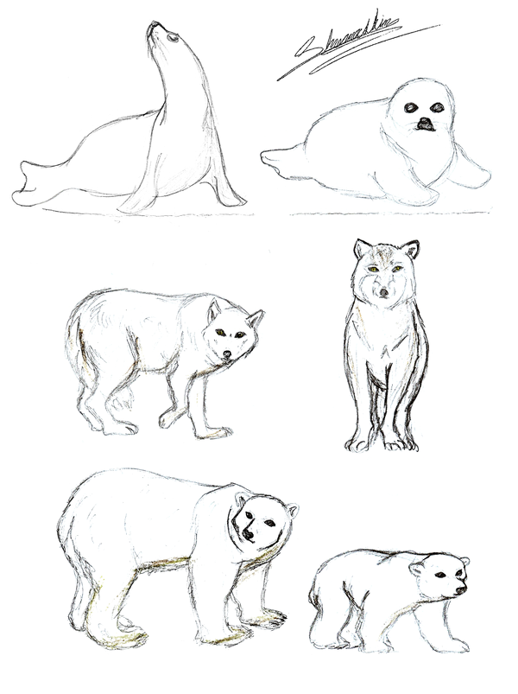
Draw at least 4 different animals OR
4 different types of the same animal
Show your peers at your table and
decide which animal you should produce on
your final paper
Draw at least one animal on your final paper
with pencil, Use the entire space of your canvas
**You can create more than one animal
**You can draw objects in the background
After your animal is drawn divide your artwork into smaller shapes using a ruler
***Each shape with have a tint or shade of your selected complementary colors
**Watch your craftsmanship when drawing and applying lines ☺

Slide 33
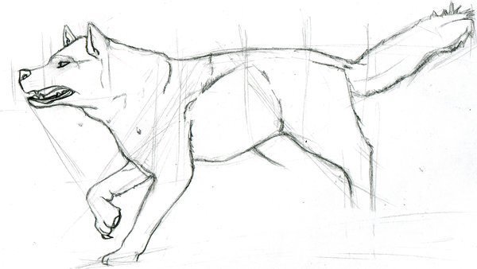
Example of taking up the entire SPACE of a canvas!

Slide 34
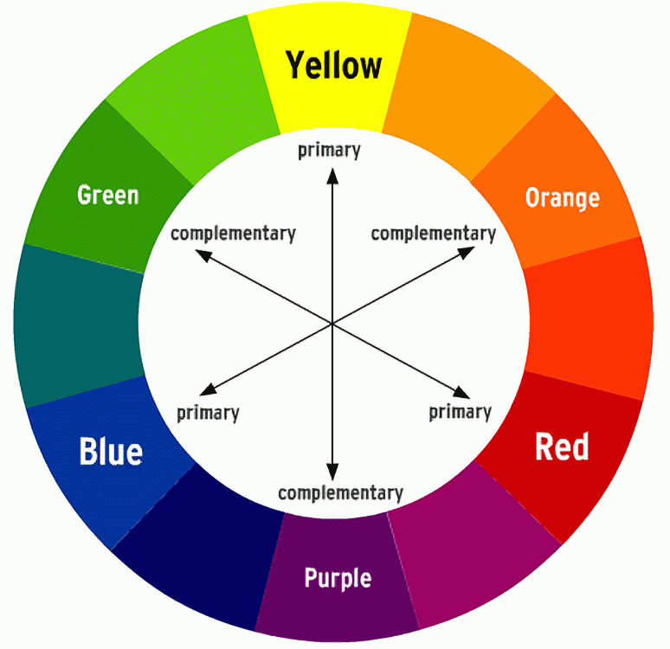

Slide 35
Complementary Colored Animal Portrait Student examples:

Slide 36
